Slide 1


Javascript for Beginners
Esa Ketonen
Project work

Slide 2

Foreword by the Author
Background:
I consulted a counselor at an unemployment office what to study to enhance my capabilities to require a work position. I commended that at least I would not study programming, but here I am.
Recommendations:
I recommend to study https://www.javascripttutorial.net and watch Frontend Masters (has a monthly fee).
Instructions:
Go through this presentation like a Javascript Engine. First parse it through and then execute it line by line. Video tips! are optional to watch.
Note!
Feel free to make me a job offer. I have my contact info at Linkedin.
The Author:
Esa Ketonen took apart to an unemployment course by Opiframe (https://opiframe.com/) called Internet of Things in Jyväskylä, Finland for seven months (14.10.2019 – 14.5.2020).
Linkedin:
https://www.linkedin.com/in/esa-ketonen-3023b7164/

Slide 3
Javascript for Beginners Introduction
Technical information:
This presentation was done with Microsoft Powerpoint. The structure of this presentation is mainly adapted from W3Schools Online Web Tutorials.
Code examples:
Code examples are done with Microsoft Visual Studio code editor (please read also the text with the code) . Other options were among others Atom, Notepad++, Brackets, Codepen, Sublime text and Vim.
Browser:
Google Crome web browser was used for console logging. Other options for web browsers were Mozilla Firefox, Microsoft Edge, Microsoft Internet Explorer, Opera, Apple Safari and so on.
Main sources for text and code examples were:
W3Schools Online Web Tutorials (https://www.w3schools.com/js/default.asp)
Mozilla Developer Networ (MDN) web docs which is the official source for Javascript. (https://developer.mozilla.org/en-US/docs/Web/JavaScript)
Doctor Axel Rauschmayer’s Speaking Javascript online books: (https://exploringjs.com/)
https://www.javascripttutorial.net and Frontend Masters public course notes
Sources: https://www.elegantthemes.com/blog/resources/best-code-editors, https://en.wikipedia.org/wiki/List_of_web_browsers

Slide 4

The history of Javascript (ECMAScript)
JavaScript (JS) was invented in 1995. Javascript became an ECMA standard in 1997. ECMAScript (ES) is the official name of the language.
Version ES6 was released in 2015 and was renamed to ECMAScript 2015. Since that ECMAScript is named by year. ECMAScript 2020 is the newest version.
HTML (Hypertext Markup Language) defines a webpage's structure and content.
CSS (Cascading Style Sheets) sets the formatting and webpage's appearance.
JavaScript adds interactivity to a webpage.
Sources: https://developer.mozilla.org/en-US/docs/Web/JavaScript/JavaScript_technologies_overview, https://en.wikipedia.org/wiki/ECMAScript and https://www.w3schools.com/js/default.asp
https://github.com/BrendanEich
Brendan Eich created JavaScript, co-founded Mozilla and Firefox.
JavaScript was developed for Netscape. After Netscape the Mozilla foundation continued to develop JavaScript for the Firefox browser.
JavaScript is commonly used for client-side scripting on the World Wide Web, and it is increasingly being used for writing server applications and services using Node.js.

Slide 5
The history of Javascript (ECMAScript) 2
The ECMAScript specification is a standardized specification of a scripting language. Initially it was named Mocha, later LiveScript, and finally JavaScript.
A new name became necessary because there is a trademark on JavaScript (held originally by Sun, now by Oracle). At the moment, Mozilla is one of the few companies allowed to officially use the name JavaScript because it received a license long ago.
For common usage, these rules apply:
JavaScript means the programming language.
ECMAScript is the name used by the language specification.
JavaScript’s creator, Brendan Eich, had no choice but to create the Mocha very quickly (in just ten days or other, worse technologies would have been adopted by Netscape).
He borrowed from several programming languages:
Java (syntax, primitive values versus objects), Scheme and AWK (first-class functions), Self (prototypal inheritance), and Perl and Python (strings, arrays, and regular expressions).
Since that Javascript has evolved for 25 years.
Sources: https://en.wikipedia.org/wiki/ECMAScript and http://speakingjs.com/es5/ch01.html

Slide 6
DOM and HTML DOM
When a web page is loaded, the browser creates a Document Object Model (DOM) of the page.
The DOM is a W3C (World Wide Web Consortium) standard.
The DOM defines a standard for accessing documents.
The W3C DOM standard is separated into 3 different parts:
Core DOM - standard model for all document types
XML DOM - standard model for XML documents
HTML DOM - standard model for HTML documents
Source: https://www.w3schools.com/js/js_htmldom.asp
With the HTML DOM, JavaScript can access and change all the elements of an HTML document.
The HTML DOM is a standard object model and programming interface for HTML. It defines:
The HTML elements as objects
The properties of all HTML elements
The methods to access all HTML elements
The events for all HTML elements
The HTML DOM is a standard for how to get, change, add, or delete HTML elements.

Slide 7

HTML DOM Navigation
With the HTML DOM, you can navigate the node tree using node relationships.
DOM Nodes: According to the W3C HTML DOM standard, everything in an HTML document is a node.
The entire document is a document node. Every HTML element is an element node. The text inside HTML elements are text nodes. Every HTML attribute is an attribute node (deprecated). All comments are comment nodes.
With the HTML DOM, all nodes in the node tree can be accessed by JavaScript.
New nodes can be created, and all nodes can be modified or deleted.
Source: https://www.w3schools.com/js/js_htmldom.asp
The HTML DOM (Document Object Model)
When a web page is loaded, the browser creates a Document Object Model of the page.
The HTML DOM model is constructed as a tree of Objects.

Slide 8
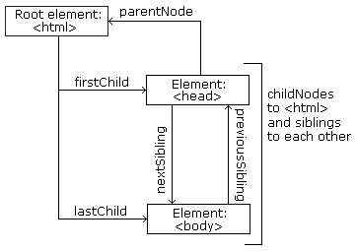
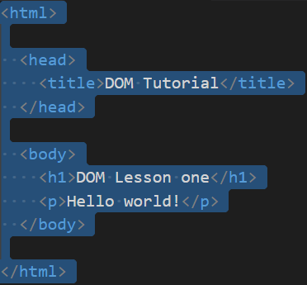
HTML DOM Navigation 2
Node Relationships:
The nodes in the node tree have a hierarchical relationship to each other.
The terms parent, child, and sibling are used to describe the relationships.
In a node tree, the top node is called the root (or root node).
Every node has exactly one parent, except the root (which has no parent).
A node can have a number of children.
Siblings (brothers or sisters) are nodes with the same parent.
Source: https://www.w3schools.com/js/js_htmldom_navigation.asp

Slide 9
HTML DOM Navigation 3
From the html above you can read: <html> is the root node/<html> has no parents /<html> is the parent of <head> and <body>/<head> is the first child of <html>/<body> is the last child of <html>.
and:
<head> has one child: <title>/<title> has one child (a text node): "DOM Tutorial“/<body> has two children: <h1> and <p>/<h1> has one child: "DOM Lesson one“/<p> has one child: "Hello world!“/<h1> and <p> are siblings.
Source: https://www.w3schools.com/js/js_htmldom_navigation.asp

Slide 10
HTML DOM Navigation 4
Navigating Between Nodes:
You can use the following node properties to navigate between nodes with JavaScript:
parentNode
childNodes[nodenumber]
firstChild
lastChild
nextSibling
previousSibling
Source: https://www.w3schools.com/js/js_htmldom_navigation.asp

Slide 11
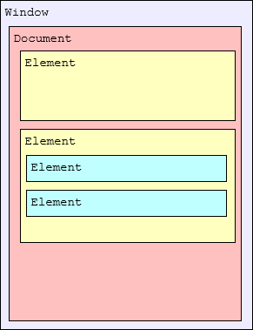
HTML DOM: Element Interface
Nodes do not have any concept of including the content that is actually displayed in the document. They are empty vessels.
The fundamental notion of a node that can represent visual content is introduced by the Element interface.
An Element object instance represents a single element in a document created using either HTML or an XML vocabulary such as SVG.
For example, consider a document with two elements, one of which has two more elements nested inside it:
Source: https://developer.mozilla.org/en-US/docs/Web/API/HTML_DOM_API
While the Document interface is defined as part of the DOM specification, the HTML specification significantly enhances it to add information specific to using the DOM in the context of a web browser, as well as to using it to represent HTML documents specifically.

Slide 12
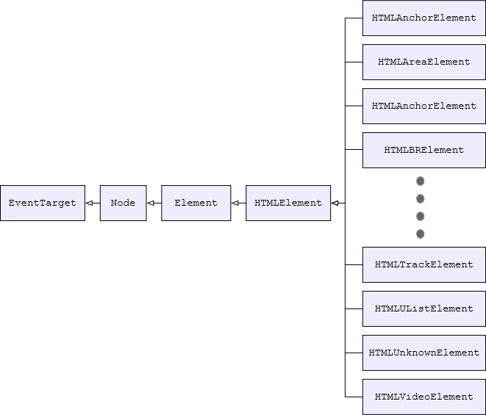
HTML DOM: HTML Element Interface
In order to expand upon the functionality of the core HTMLElement interface to provide the features needed by a specific element, the HTMLElement class is subclassed to add the needed properties and methods.
For example, the <canvas> element is represented by an object of type HTMLCanvasElement. HTMLCanvasElement augments the HTMLElement type by adding properties such as height and methods like getContext() to provide canvas-specific features.
The overall inheritance for HTML element classes looks like this:
Source: https://developer.mozilla.org/en-US/docs/Web/API/HTML_DOM_API

Slide 13
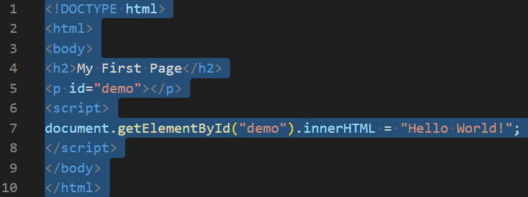
HTML DOM Methods
HTML DOM methods are actions you can perform (on HTML Elements).
HTML DOM properties are values (of HTML Elements) that you can set or change.
The HTML DOM can be accessed with JavaScript (and with other programming languages).
In the DOM, all HTML elements are defined as objects.
The programming interface is the properties and methods of each object.
Source: https://www.w3schools.com/js/js_htmldom_methods.asp
A property is a value that you can get or set (like changing the content of an HTML element).
A method is an action you can do (like add or deleting an HTML element).
The above example changes the content (the innerHTML) of the <p> element with id="demo":
In the example above, getElementById is a method, while innerHTML is a property.

Slide 14
HTML DOM Events
An HTML event can be something the browser does, or something a user does.
Here are some examples of HTML events:
HTML web page has finished loading
HTML input field was changed
HTML button was clicked
Often, when events happen, you may want to do something. JavaScript lets you execute code when events are detected.
Sources: https://www.w3schools.com/js/js_events.asp and https://developer.mozilla.org/en-US/docs/Web/API/Document_Object_Model/Introduction
HTML allows event handler attributes, with JavaScript code, to be added to HTML elements.
It is more common to see event attributes calling functions.
The Event interface represents an event which takes place in the DOM.
The Document Object Model (DOM) is a programming interface for HTML and XML documents. A Web page is a document.
This article offers a list of events:
https://developer.mozilla.org/en-US/docs/Web/Events

Slide 15
HTML DOM Events 2
DOM Events are sent to notify code of interesting things that have taken place. Each event is represented by an object which is based on the Event interface and may have additional custom fields and/or functions used to get additional information about what happened.
Events can represent everything from basic user interactions to automated notifications of things happening in the rendering model. Some are standard events defined in official specifications, while others are events used internally by specific browsers.
Sources: https://www.w3schools.com/js/js_events.asp and https://developer.mozilla.org/en-US/docs/Web/Events
Event | Description
onchange | An HTML element has been changed
onclick | The user clicks an HTML element
onmouseover | The user moves the mouse over an HTML element
onmouseout | The user moves the mouse away from an HTML element
onkeydown | The user pushes a keyboard key
onload | The browser has finished loading the page
Common HTML Events:
Here is a list of some common HTML events: Event handlers can be used to handle, and verify, user input, user actions, and browser actions. Many different methods can be used to let JavaScript work with events.

Slide 16
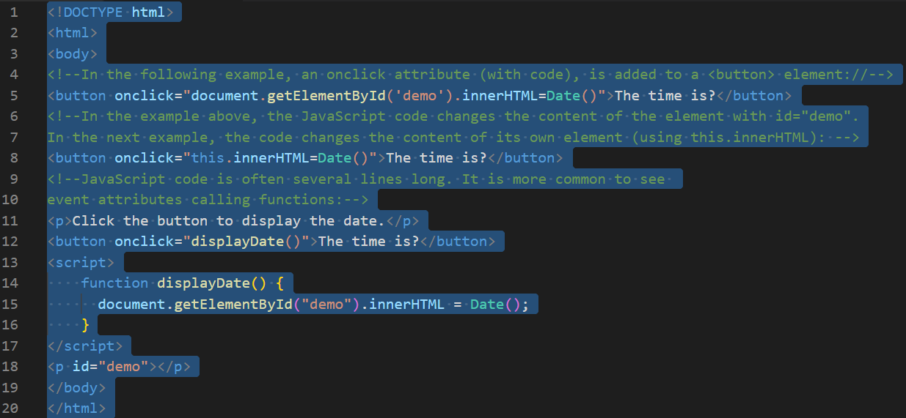
HTML DOM Events 3
Source: https://www.w3schools.com/js/js_events.asp

Slide 17
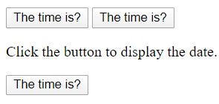
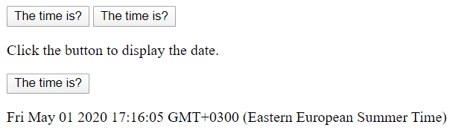
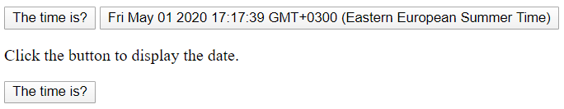
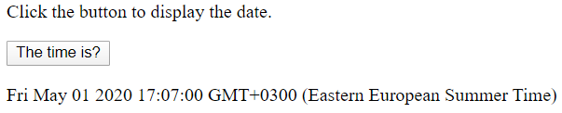
HTML DOM Events 4
Source: https://www.w3schools.com/js/tryit.asp?filename=tryjs_event_onclick

Slide 18
The Browser Object Model (BOM)
There are no official standards for the Browser Object Model (BOM).
The window object is supported by all browsers. It represents the browser's window. The Document Object Model (DOM) is an architecture that describes the structure of a document.
All global JavaScript objects, functions, and variables automatically become members of the window object.
Global variables are properties of the window object.
Global functions are methods of the window object.
The document object (of the HTML DOM) is a property of the window object:
Source: https://www.w3schools.com/js/js_window.asp
On the MDN Mozilla web pages window and Web API are used instead of BOM (BOM is not mentioned at all).
Sources: https://developer.mozilla.org/en-US/docs/Web/API/Window and https://developer.mozilla.org/en-US/docs/Web/API/HTML_DOM_API

Slide 19
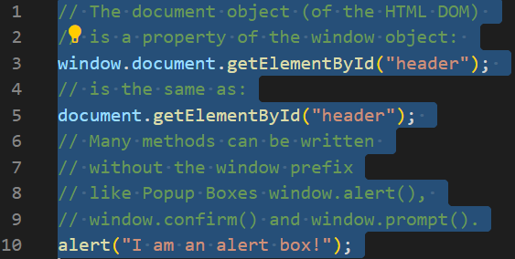
The Browser Object Model (BOM) 2
BOM main task is to manage browser windows and enable communication between the windows.
Each HTML page which is loaded into a browser window becomes a Document object and document object is an object in the BOM.
You can say BOM is super set of DOM. BOM has many objects, methods, and properties that are not the part of the DOM structure. The important BOM objects and methods are as:
document
location
history
navigator
screen
frames
popup alert
timing
cookies
Sources: https://www.dotnettricks.com/learn/javascript/dom-bom and https://www.w3schools.com/js/js_window.asp

Slide 20
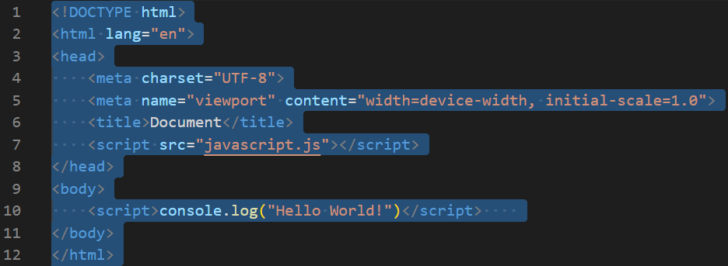
Where to place Javascript
Option 1 In HTML, JavaScript code must be inserted between <script> and </script> tags. Scripts can be placed in the <body>, or in the <head> section of an HTML page, or in both. Placing scripts at the bottom of the <body> element improves the display speed, because script interpretation slows down the display.
Option 2 Scripts can also be placed in external files. JavaScript files have the file extension .js. To use an external script, put the name of the script file in the src (source) attribute of a <script> tag.
Source: https://www.w3schools.com/js/js_whereto.asp

Slide 21
Modules
JavaScript programs can be in separate modules beeing imported when needed. Node.js has had this ability for a long time, and there are a number of JavaScript libraries and frameworks that enable module usage (for example, other CommonJS and AMD-based module systems like RequireJS, and more recently Webpack and Babel).
Exporting module features: The first thing you do to get access to module features is export them. This is done using the export statement.
You can export functions, var, let, const, and classes. They need to be top-level items; you can't use export inside a function, for example.
A more convenient way of exporting all the items you want to export is to use a single export statement at the end of your module file, followed by a comma-separated list of the features you want to export wrapped in curly braces. For example:
export { name, draw, reportArea, reportPerimeter };
Importing features into your script
Once you've exported some features out of your module, you need to import them into your script to be able to use them. The simplest way to do this is as follows:
import { name, draw, reportArea, reportPerimeter } from './modules/square.js';
You use the import statement, followed by a comma-separated list of the features you want to import wrapped in curly braces, followed by the keyword from, followed by the path to the module file.
We are using the dot (.) syntax to mean "the current location", followed by the path beyond that to the file we are trying to find. This is much better than writing out the entire relative path each time, as it is shorter, and it makes the URL portable.
Source: https://developer.mozilla.org/en-US/docs/Web/JavaScript/Guide/Modules

Slide 22
Modules 2
Applying the module to your HTML
Now we just need to apply the main.js module to our HTML page. This is very similar to how we apply a regular script to a page, with a few notable differences.
First of all, you need to include type="module" in the <script> element, to declare this script as a module:
<script type="module" src="main.js"></script>
Source: https://developer.mozilla.org/en-US/docs/Web/JavaScript/Guide/Modules
The script into which you import the module features basically acts as the top-level module. If you omit it, Firefox for example gives you an error of "SyntaxError: import declarations may only appear at top level of a module".
You can only use import and export statements inside modules; not regular scripts.
Note! You can also import modules into internal scripts, as long as you include type="module", for example <script type="module"> //include script here </script>.

Slide 23
Modules 3
Default exports versus named exports:
The functionality we've exported so far has been comprised of named exports — each item (be it a function, const, etc.) has been referred to by its name upon export, and that name has been used to refer to it on import as well.
There is also a type of export called the default export — this is designed to make it easy to have a default function provided by a module, and also helps JavaScript modules to interoperate with existing CommonJS and AMD module systems.
Source: https://developer.mozilla.org/en-US/docs/Web/JavaScript/Guide/Modules
Aside: .mjs versus .js
Throughout this article, we've used .js extensions for our module files, but in other resources you may see the .mjs extension used instead. V8's documentation recommends this, for example.
The reasons given are:
It is good for clarity, i.e. it makes it clear which files are modules, and which are regular JavaScript.
It ensures that your module files are parsed as a module by runtimes such as Node.js, and build tools such as Babel.
However, we decided to keep to using .js.

Slide 24
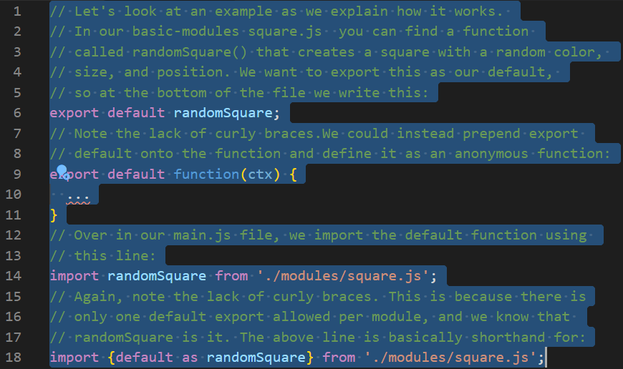
Modules 4
Source: https://developer.mozilla.org/en-US/docs/Web/JavaScript/Guide/Modules

Slide 25
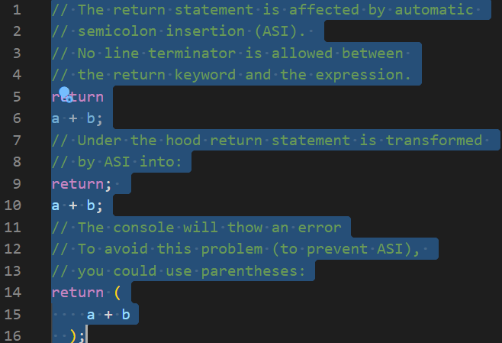
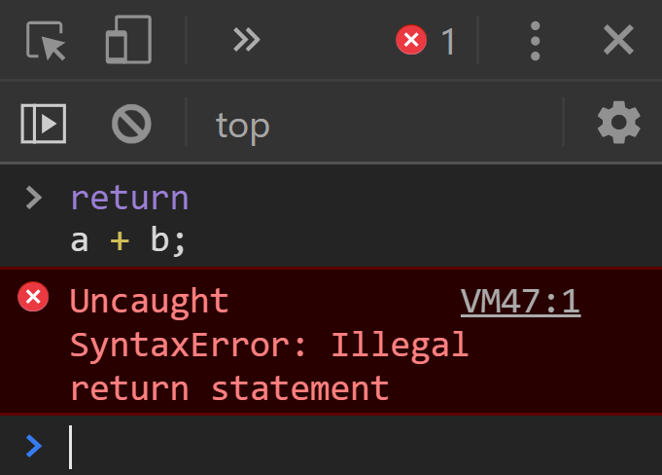
Automatic semicolon insertion (ASI)
On the line 9 a semi-colon is automatically inserted by ASI.
Source: https://developer.mozilla.org/en-US/docs/Web/JavaScript/Reference/Statements/return
This is a Google Crome web browser screenshot of a console.
It is recommended to use Google Crome web browser over Edge or Internet Explorer browsers.

Slide 26
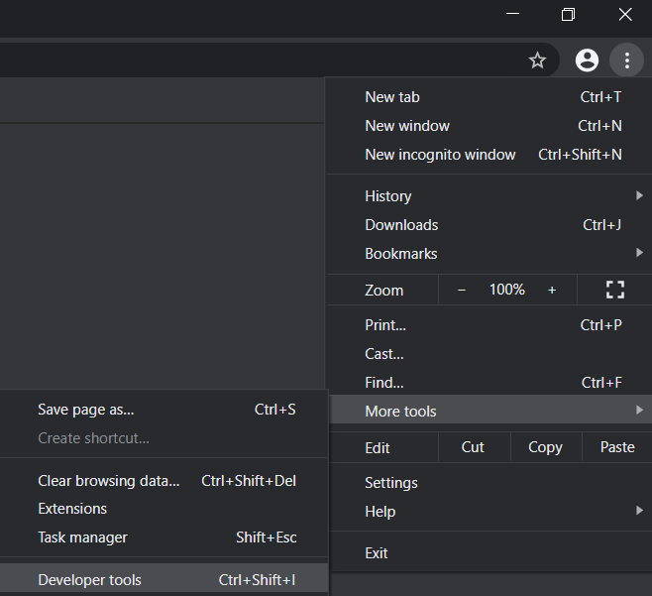
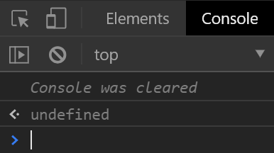
Web Browser Console
You can access Google Crome web browser console by opening the browser and selecting three dots from the upper right corner – more tools – developer tools or with a key combination ctrl +shift+i or with a keystroke of F12
You can clear the console by writing clear() to the console and press enter or by clicking the sign circled in red or with a key combination Ctlr + L.

Slide 27
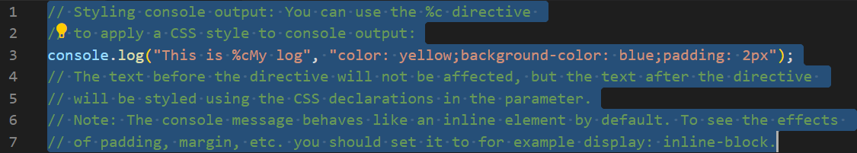
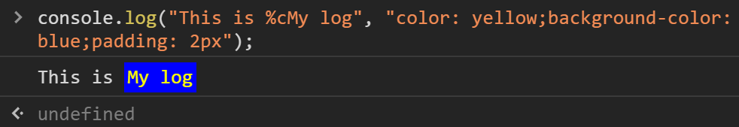
Web Browser Console 2
Anything you type into the console at the prompt will be evaluated as a Javascript expression and the results of the expression will be echoed beneath the command prompt. If an error occurs, the stack trace of the error will be output instead. If the expression doesn't return a value, the console will report undefined. It's just letting you know that the previous expression didn't return a result.
Sources: https://developer.mozilla.org/en-US/docs/Web/API/Console and https://commandlinefanatic.com/cgi-bin/showarticle.cgi?article=art041

Slide 28
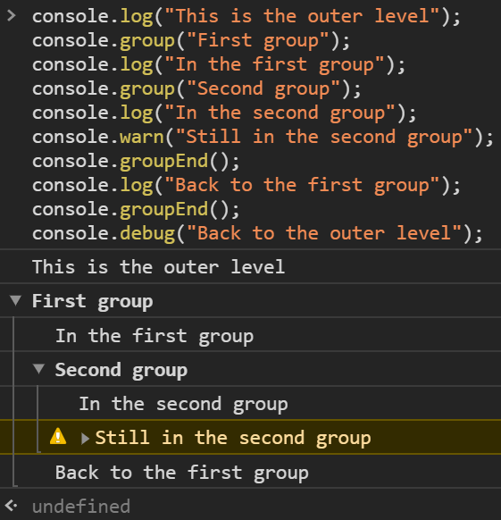
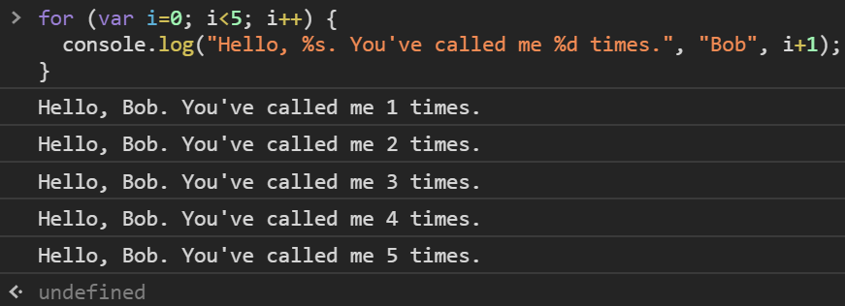
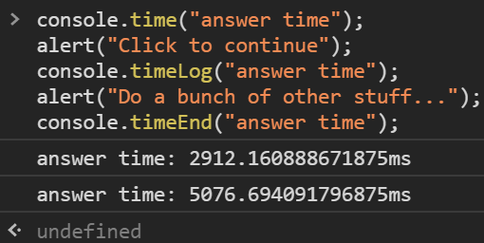
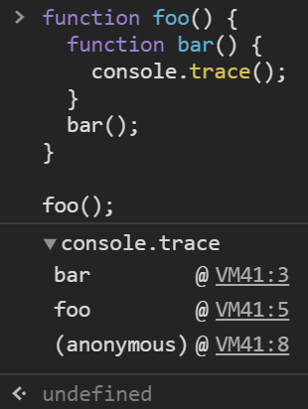
Web Browser Console 3
From left to right: Using groups in the console,
using string substitutions, timers and stack traces.
Source: https://developer.mozilla.org/en-US/docs/Web/API/console

Slide 29
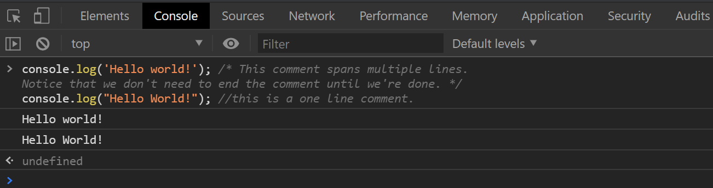
Console.log()
It is possible to test your Javasript by using console.log() in the browser console. At the end, console.log() always prints a newline. Therefore, if you call it with zero arguments, it just prints a newline.
JavaScript accepts both “double” and ‘single’ quotes. You can use quotes inside a string, as long as they don't match the quotes surrounding the string. ”I am John ’the man’ ” and ’I am John ”the man” ’.
JavaScript comments: Single line comments start with //. JavaScript Block comments: Multi-line comments start with /* and end with */. Use single line comments. Block comments are often used for formal documentation.
Sources: https://www.w3schools.com/js/js_intro.asp and https://www.w3schools.com/js/js_comments.asp

Slide 30
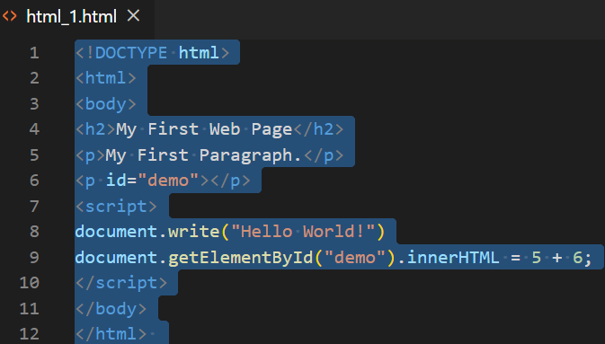
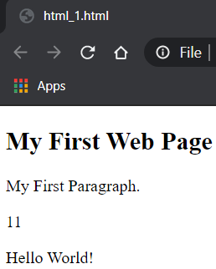
Document.write() and Document.getElementById()
For testing purposes, it is convenient to use document.write(). WARNING ! Using document.write() after an HTML document is loaded, will delete all existing HTML.
Source: https://www.w3schools.com/js/js_output.asp
To access an HTML element, JavaScript can use the document.getElementById(id) method. The id attribute defines the HTML element. The innerHTML property defines the HTML content.

Slide 31
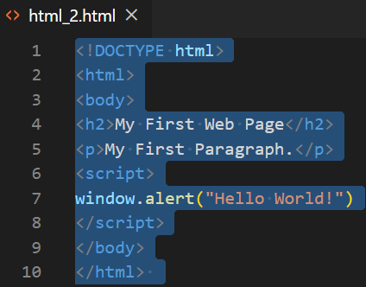
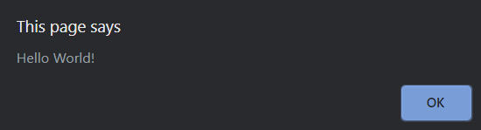
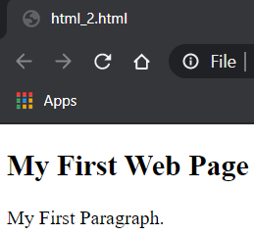
Window.alert()
The alert() method displays an alert box with a specified message and an OK button. An alert box is often used if you want to make sure information comes through to the user.
Source: https://www.w3schools.com/js/js_output.asp
Note! This page says Hello World! alert has to be clicked ok before the actual webpage is shown.

Slide 32
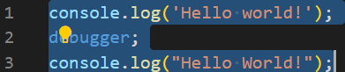
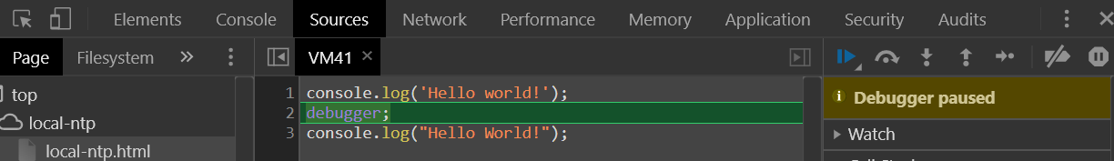
Debugger
Searching for (and fixing) errors in programming code is called code debugging. The first known computer bug was a real bug (an insect) stuck in the electronics. Errors are also called bugs.
The debugger keyword stops the execution of JavaScript, and calls (if available) the debugging function.
In the debugger window, you can set breakpoints in the JavaScript code. At each breakpoint, JavaScript will stop executing, and let you examine JavaScript values. After examining values, you can resume the execution of code (typically with a play button).
Source: https://www.w3schools.com/js/js_debugging.asp

Slide 33
V8 Javascript Engine
V8 is Google’s open source high-performance JavaScript and WebAssembly engine, written in C++.
It is used in Chrome and in Node.js, among others. It implements ECMAScript and WebAssembly, and runs on Windows 7 or later, macOS 10.12+, and Linux systems that use x64, IA-32, ARM, or MIPS processors.
V8 can run standalone or can be embedded into any C++ application.
V8 compiles and executes JavaScript source code, handles memory allocation for objects, and garbage collects objects it no longer needs. V8’s stop-the-world, generational, accurate garbage collector is one of the keys to V8’s performance.
JavaScript is commonly used for client-side scripting in a browser, being used to manipulate Document Object Model (DOM) objects for example. The DOM is not, however, typically provided by the JavaScript engine but instead by a browser.
The same is true of V8. Google Chrome provides the DOM. V8 does however provide all the data types, operators, objects and functions specified in the ECMA standard.
V8 enables any C++ application to expose its own objects and functions to JavaScript code. It’s up to you to decide on the objects and functions you would like to expose to JavaScript.
Sources: https://v8.dev/ and https://v8.dev/docs

Slide 34
Browser Engine: Rendering Engines and Javascript Engines
A browser engine can be thought of as the heart of a browser, it helps to present the content of a website after you hit the URL of the web address you wish to visit. It does so by understanding the HTML, CSS, and JavaScript written on your web page.
A browser engine is responsible for everything from the text you see in the HTML code to the graphical presentation of that code on the browser with the help of Javascript engine and rendering engine.
Browser engines are uniquely designed for every browser leading to cross browser compatibility issues.
Source: https://www.lambdatest.com/blog/browser-engines-the-crux-of-cross-browser-compatibility/
Browser Engine comprises of two parts: Rendering Engine and Javascript Engine
Browser | Crome | Internet Explorer | Firefox | Edge | Opera | Safari
Rendering Engine | Blink | Trident | Gecko | EdgeHTML | Blink | WebKit
Javascript Engine | V8 | Chakra | SpiderMonkey | Chakra | V8 | Nitro

Slide 35
Memory Management
JavaScript automatically allocates memory when objects are created and frees it when they are not used anymore (garbage collection).
Memory life cycle: Regardless of the programming language, the memory life cycle is pretty much always the same.
Allocate the memory you need.
Use the allocated memory (read, write).
Release the allocated memory when it is not needed anymore.
The second part is explicit in all languages. The first and last parts are explicit in low-level languages but are mostly implicit in high-level languages like JavaScript.
JavaScript, utilize a form of automatic memory management known as garbage collection (GC).
The purpose of a garbage collector is to monitor memory allocation and determine when a block of allocated memory is no longer needed and reclaim it.
This automatic process is an approximation since the general problem of determining whether or not a specific piece of memory is still needed is undecidable.
Source: https://developer.mozilla.org/en-US/docs/Web/JavaScript/Memory_Management

Slide 36
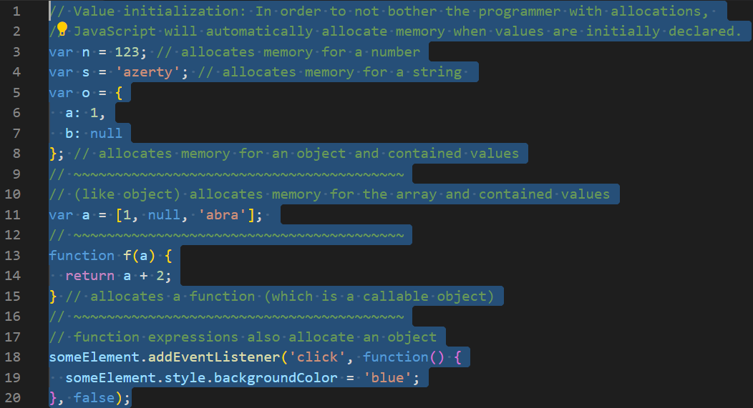
Memory Management 2
Source: https://developer.mozilla.org/en-US/docs/Web/JavaScript/Memory_Management

Slide 37
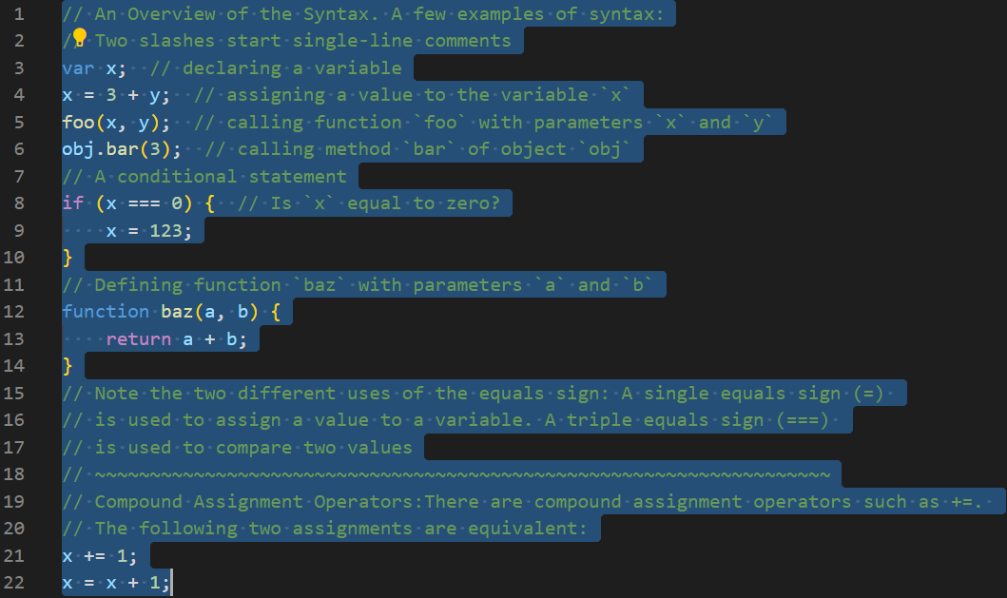
Syntax: Overview
Source: http://speakingjs.com/es5/ch01.html
Video Tip!
https://www.youtube.com/watch?v=2pL28CcEijU
What the... JavaScript? | Kyle Simpson
Video Tip!
https://www.youtube.com/watch?v=aX3ZABCdC38
dotJS 2017 A Brief History of JavaScript | Brendan Eich

Slide 38
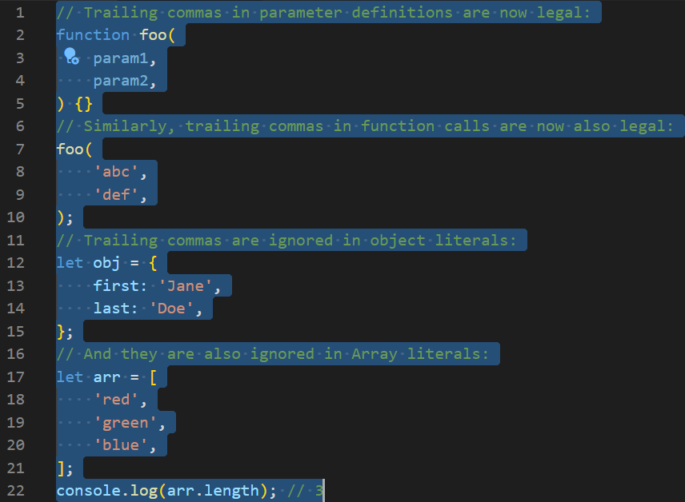
Syntax: Trailing Commas
Source: https://exploringjs.com/es2016-es2017/ch_trailing-comma-parameters.html
Video Tip!
https://www.youtube.com/watch?v=fX5HhslNAbc
Promises, Generators, Async (JavaScript training) | Kyle Simpson
Video Tip!
https://www.youtube.com/watch?v=9rW0H5FvWeA
The Functional Programming Concept You Should be Using Right now | Bianca Gandolfo
Video Tip!
https://www.youtube.com/watch?v=8W6zoAmYVK8
JavaScript Fundamentals for Functional Programming (JavaScript training) | Bianca Gandolfo

Slide 39
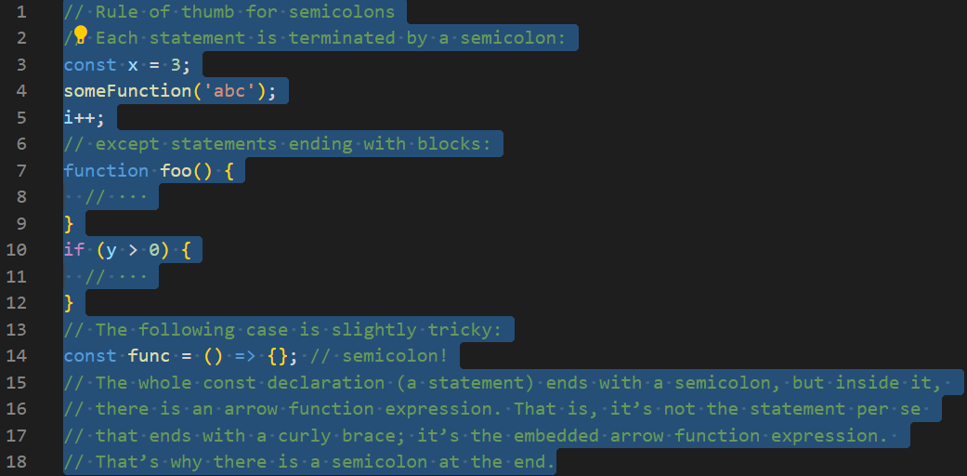
Syntax: Semicolons
Source: https://exploringjs.com/impatient-js/ch_syntax.html#semicolons
Video Tip!
https://www.youtube.com/watch?v=hQVTIJBZook
JavaScript: The Good Parts | Douglas Crockford
Video Tip!
https://www.youtube.com/watch?v=lil4YCCXRYc
Async Programming in ES7 JSConf US 2015 | Jafar Husain

Slide 40
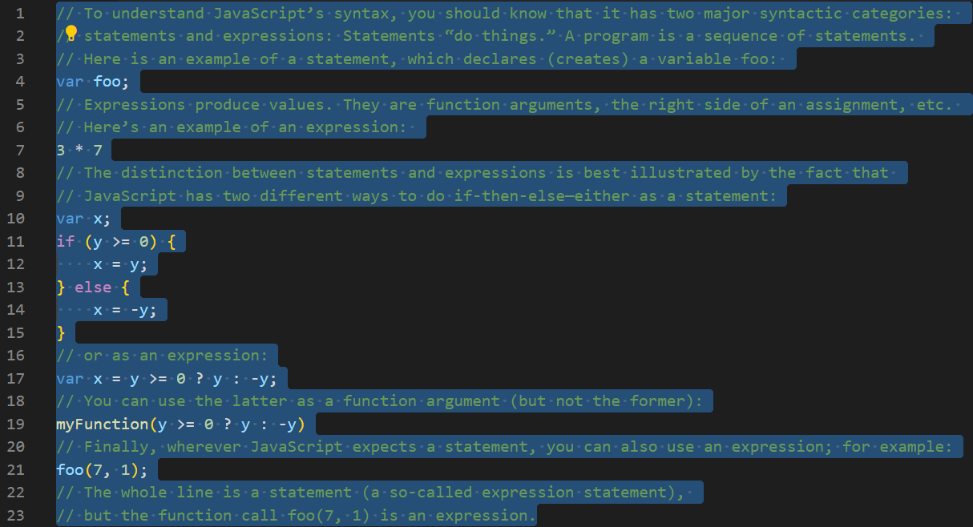
Syntax: Statements versus Expressions
Source: http://speakingjs.com/es5/ch01.html
Video Tip!
https://www.youtube.com/watch?v=qouPzSryggk
Netflix JavaScript Talks - Human Performance | Jem Young

Slide 41
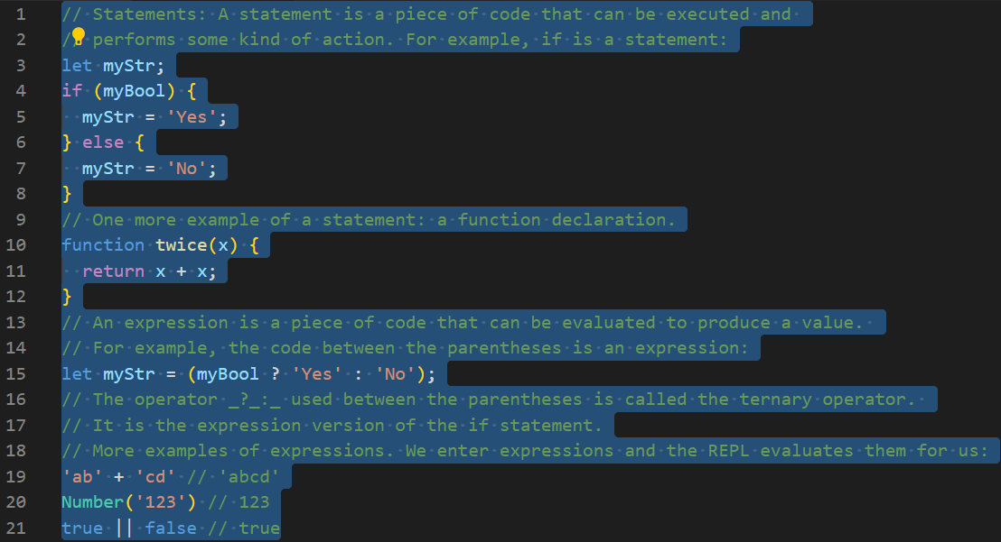
Syntax: Statements versus expressions 2
Source: https://exploringjs.com/impatient-js/ch_syntax.html#an-overview-of-javascripts-syntax
Video Tip!
https://www.youtube.com/watch?v=8aGhZQkoFbQ
What the heck is the event loop anyway? JSConf EU | Philip Roberts

Slide 42
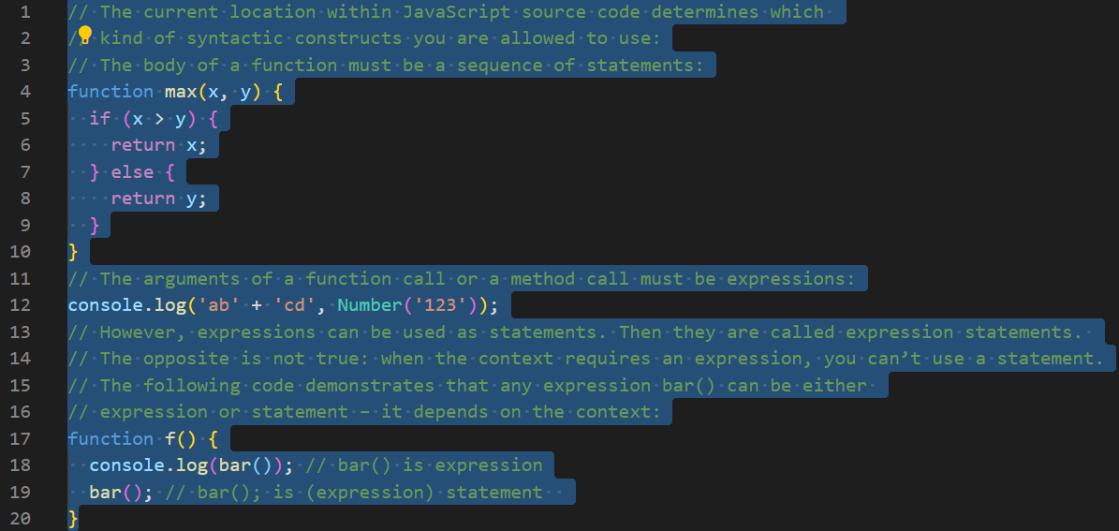
Syntax: Statements versus expressions 3
Source: https://exploringjs.com/impatient-js/ch_syntax.html#an-overview-of-javascripts-syntax
Video Tip! https://www.youtube.com/watch?v=exrc_rLj5iw
An Introduction to Functions, Execution Context and the Call Stack (FULL VIDEO - Parts 1-3) | Will Sentence

Slide 43
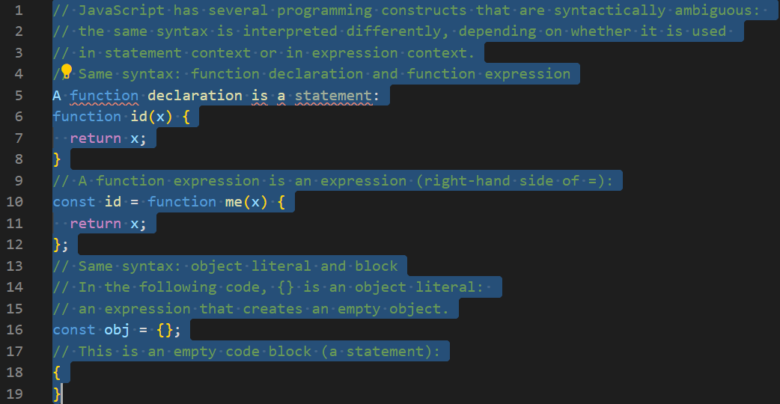
Ambiguous Syntax
Source: https://exploringjs.com/impatient-js/ch_syntax.html#an-overview-of-javascripts-syntax
Video Tip!
https://www.youtube.com/watch?v=Bv_5Zv5c-Ts
JavaScript: Understanding the Weird Parts - The First 3.5 Hours | Tony Alicea

Slide 44
Syntax: The Temporal Dead Zone
A variable declared by let or const has a so-called temporal dead zone (TDZ): When entering its scope, it can’t be accessed (got or set) until execution reaches the declaration. Let’s compare the life cycles of var-declared variables (which don’t have TDZs) and let-declared variables (which have TDZs).
The life cycle of var-declared variables: var variables don’t have temporal dead zones. Their life cycle comprises the following steps:
When the scope (its surrounding function) of a var variable is entered, storage space (a binding) is created for it. The variable is immediately initialized, by setting it to undefined.
When the execution within the scope reaches the declaration, the variable is set to the value specified by the initializer (an assignment) – if there is one. If there isn’t, the value of the variable remains undefined.
The life cycle of let-declared variables: Variables declared via let have temporal dead zones and their life cycle looks like this:
When the scope (its surrounding block) of a let variable is entered, storage space (a binding) is created for it. The variable remains uninitialized. Getting or setting an uninitialized variable causes a ReferenceError.
When the execution within the scope reaches the declaration, the variable is set to the value specified by the initializer (an assignment) if there is one. If there isn’t then the value of the variable is set to undefined. const variables work similarly to let variables, but they must have an initializer (i.e., be set to a value immediately) and can’t be changed.
Source: https://exploringjs.com/es6/ch_variables.html#sec_temporal-dead-zone

Slide 45
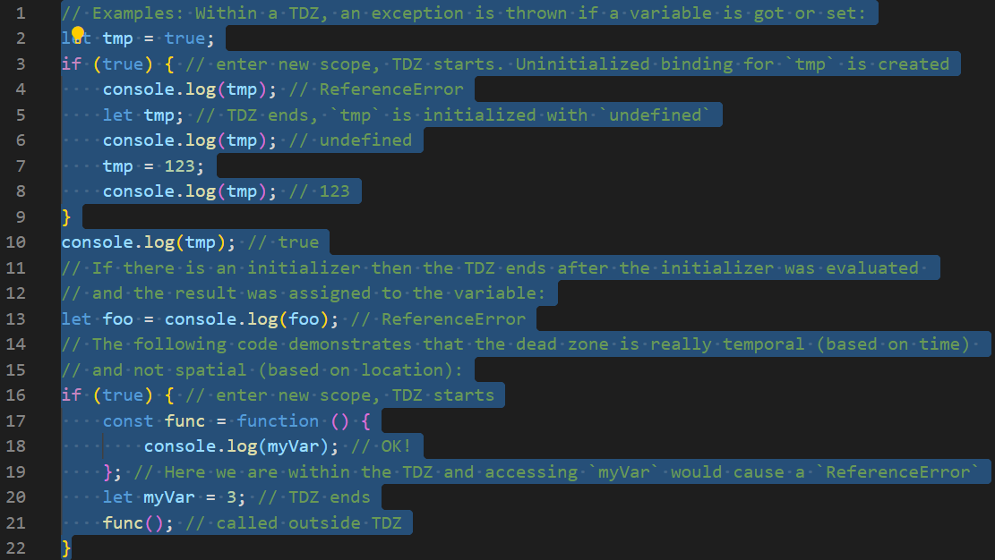
Syntax: The Temporal Dead Zone 2
Source: https://exploringjs.com/es6/ch_variables.html#sec_temporal-dead-zone

Slide 46
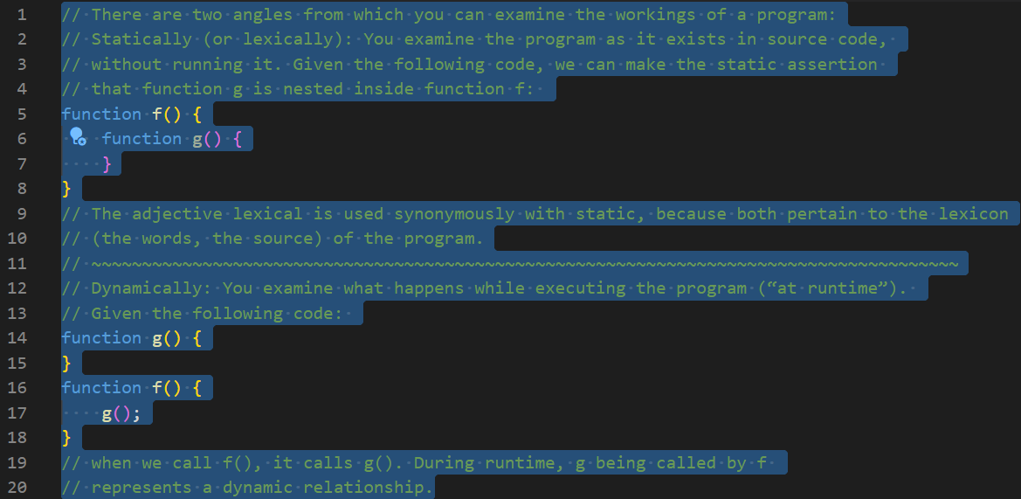
Syntax: Static versus Dynamic
Source: http://speakingjs.com/es5/ch16.html#_declaring_a_variable

Slide 47
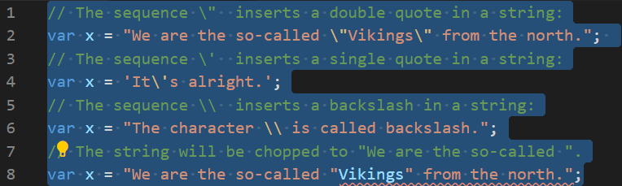
Escape Characters
Code | Result | Description
\' | ' | Single quote
\" | " | Double quote
\\ | \ | Backslash
The escape characters above on the right were originally designed to control typewriters, teletypes, and fax machines. They do not make any sense in HTML.
Because strings must be written within quotes the text on the line 8 will be chopped to "We are the so-called".
Source: https://www.w3schools.com/js/js_strings.asp
Code | Result
\b | Backspace
\f | Form Feed
\n | New Line
\r | Carriage Return
\t | Horizontal Tabulator
\v | Vertical Tabulator

Slide 48
Reserved Keywords as of ECMAScript 2015
Reserved keywords
abstract | arguments | await* | boolean
break | byte | case | catch
char | class* | const | continue
debugger | default | delete | do
double | else | enum* | eval
export* | extends* | false | final
finally | float | for | function
goto | if | implements | import*
in | instanceof | int | interface
let* | long | native | new
null | package | private | protected
public | return | short | static
super* | switch | synchronized | this
throw | throws | transient | true
try | typeof | var | void
volatile | while | with | yield
In JavaScript you cannot use reserved keywords as variables, labels, or function names.
Words marked with* are new in ECMAScript 5 and ECMAScript 6.
Additionally, the literals null, true, and false cannot be used as identifiers in ECMAScript.
In the year 2015 ECMA International published ECMAScript 6 or ES6 which was later renamed (ECMAScript 2015).
Since 2015, ECMAScript-standard has been updated and named by year. ECMAScript 2020 is the newest version (https://tc39.es/ecma262/).
Source: https://www.w3schools.com/js/js_reserved.asp

Slide 49
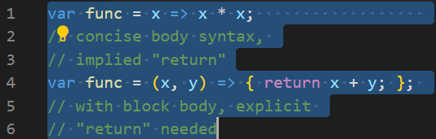
Operators
JavaScript has the following types of operators:
Assignment operators
Comparison operators
Arithmetic operators
Bitwise operators
Logical operators
Note! (=>) is not an operator, but the notation for Arrow functions. Arrow functions can have either a "concise body" or the usual "block body".
In a concise body, only an expression is specified, which becomes the implicit return value. In a block body, you must use an explicit return statement.
String operators
Conditional (ternary) operator
Comma operator
Unary operators
Relational operators
Source: https:/developer.mozilla.org/en-US/docs/Web/JavaScript/Guide/Expressions_and_Operators

Slide 50
Arithmetic and Assigment Operators
Operator | Description
+ | Addition
- | Subtraction
* | Multiplication
** | Exponentiation (ES2016)
/ | Division
% | Modulus (Division Remainder)
++ | Increment
-- | Decrement
Operator | Example | Same As
= | x = y | x = y
+= | x += y | x = x + y
-= | x -= y | x = x - y
*= | x *= y | x = x * y
/= | x /= y | x = x / y
%= | x %= y | x = x % y
**= | x **= y | x = x ** y
Arithmetic operators on the left are used to perform arithmetic on numbers. Assignment operators on the right assign values to JavaScript variables.
Source: https://www.w3schools.com/js/js_operators.asp

Slide 51
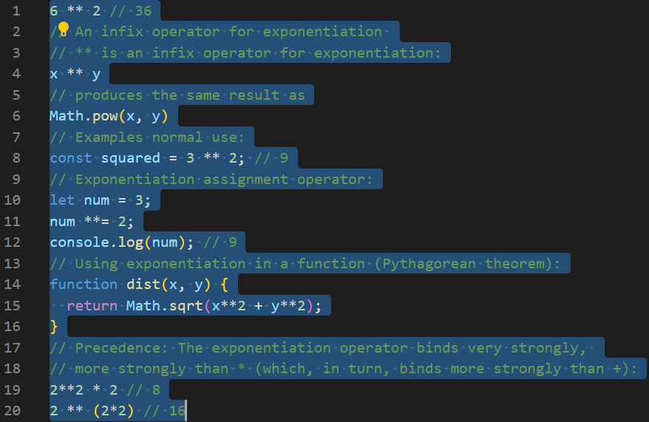
Arithmetic operators: Exponentiation operator (**)
Source: https://exploringjs.com/es2016-es2017/ch_exponentiation-operator.html

Slide 52
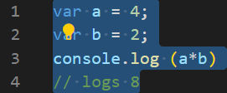
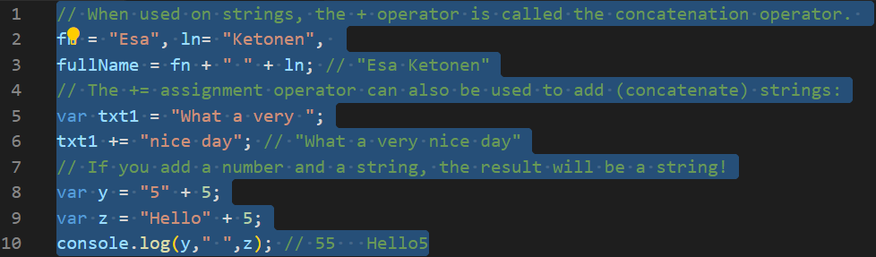
Arithmetic Operators and Operands
Operand | Operator | Operand
100 | + | 50
a | * | b
Arithmetic operators perform arithmetic on numbers (literals or variables). The numbers (in an arithmetic operation) are called operands. Literal number operands are 100 and 50 (valuates to 150). Variable operands are a and b (valuates to 8). The operation (to be performed between the two operands) is defined by an operator. Operators are (+) and (*).
Source: https://www.w3schools.com/js/js_arithmetic.asp

Slide 53
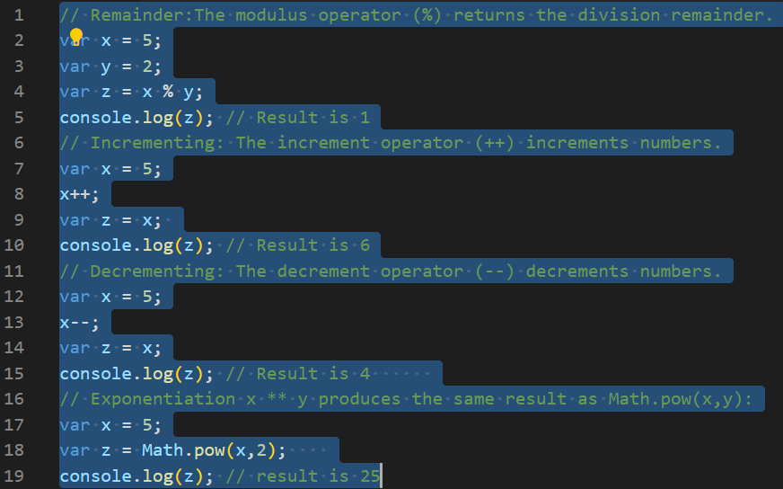
Arithmetic Operators
Source: https://www.w3schools.com/js/js_arithmetic.asp

Slide 54
Arithmetic Operator Precedence
Operator precedence describes the order in which operations are performed in an arithmetic expression. Expressions in parentheses are computed before the value is used in the rest of the expression (value 21)
The precedence can be changed by using parentheses. When many operations have the same precedence (like addition and subtraction value 14), they are computed from left to right. (The highest precedence value is 21)
Multiplication (*) and division (/) have higher precedence value 15 than addition (+) and subtraction (-) value 14.
Sources: https://www.w3schools.com/js/js_arithmetic.asp and https://developer.mozilla.org/en-US/docs/Web/JavaScript/Reference/Operators/Operator_Precedence#Table
Precedence | Operator type | Associativity | Individual operators
21 | Grouping | n/a | ( … )
20 | Member Access | left-to-right | … . …
 | Computed Member Access | left-to-right | … [ … ]
 | new (with argument list) | n/a | new … ( … )
 | Function Call | left-to-right | … ( … )

Slide 55
Comparison, Logical,Typeof and Instanceof Operators
Operator | Description
&& | logical and
|| | logical or
! | logical not
Operator | Description
== | equal to
=== | equal value and equal type
!= | not equal
!== | not equal value or not equal type
> | greater than
< | less than
>= | greater than or equal to
<= | less than or equal to
? | ternary operator
Source: https://www.w3schools.com/js/js_operators.asp
Operator | Description
typeof | Returns the type of a variable
instanceof | Returns true if an object is an instance of an object type
Comparison and logical operators are used to test for true or false. You can use the typeof operator to find the data type of a JavaScript variable. The instanceof operator returns true if the specified object is
an instance of the specified object.

Slide 56
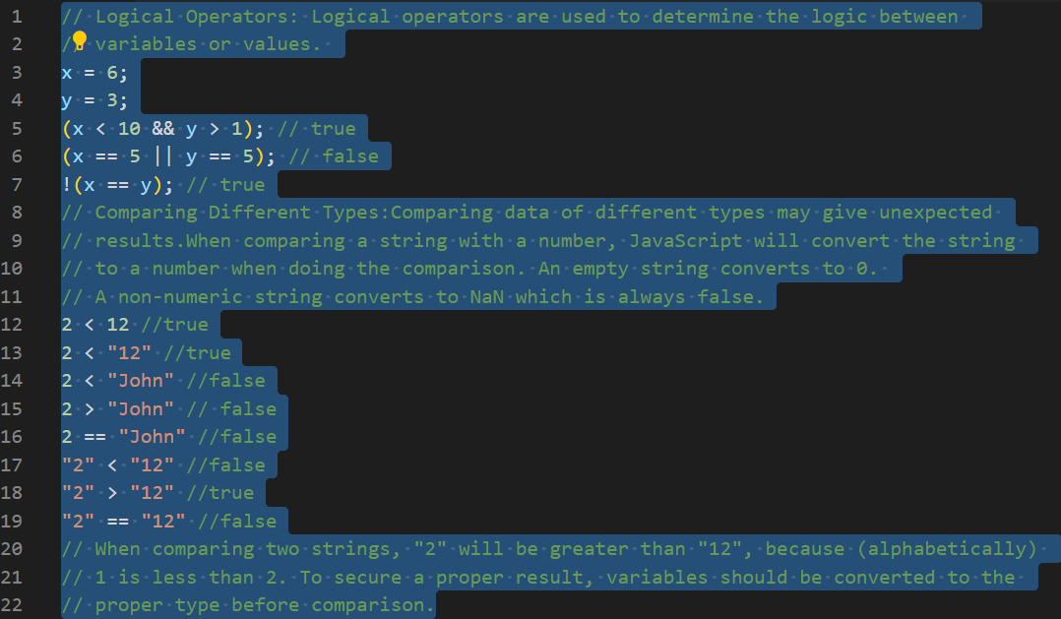
Logical and Comparison Operators
Source: https://www.w3schools.com/js/js_comparisons.asp

Slide 57
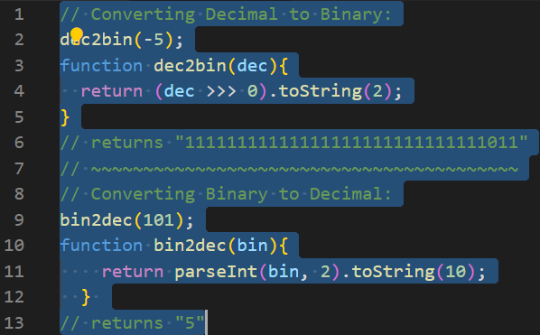
Bitwise Operations
JavaScript Uses 32 bits Bitwise Operands
JavaScript stores numbers as 64 bits floating point numbers, but all bitwise operations are performed on 32 bits binary numbers.
Before a bitwise operation is performed, JavaScript converts numbers to 32 bits signed integers.
After the bitwise operation is performed, the result is converted back to 64 bits JavaScript numbers.
Source: https://www.w3schools.com/js/js_bitwise.asp

Slide 58
Bitwise Operations 2
Operator | Name | Description
& | AND | Sets each bit to 1 if both bits are 1
| | OR | Sets each bit to 1 if one of two bits is 1
^ | XOR | Sets each bit to 1 if only one of two bits is 1
~ | NOT | Inverts all the bits
<< | Zero fill left shift | Shifts left by pushing zeros in from the right and let the leftmost bits fall off
>> | Signed right shift | Shifts right by pushing copies of the leftmost bit in from the left, and let the rightmost bits fall off
>>> | Zero fill right shift | Shifts right by pushing zeros in from the left, and let the rightmost bits fall off
JavaScript bitwise operators and examples.
The examples above uses 4 bits unsigned
binary numbers. Because of this ~ 5 returns 10. Since JavaScript uses 32 bits signed integers, it will not return 10. It will return -6.
Source: https://www.w3schools.com/js/js_bitwise.asp
Operation | Result | Same as | Result
5 & 1 | 1 | 0101 & 0001 | 0001
5 | 1 | 5 | 0101 | 0001 | 0101
~ 5 | 10 | ~0101 | 1010
5 << 1 | 10 | 0101 << 1 | 1010
5 ^ 1 | 4 | 0101 ^ 0001 | 0100
5 >> 1 | 2 | 0101 >> 1 | 0010
5 >>> 1 | 2 | 0101 >>> 1 | 0010

Slide 59
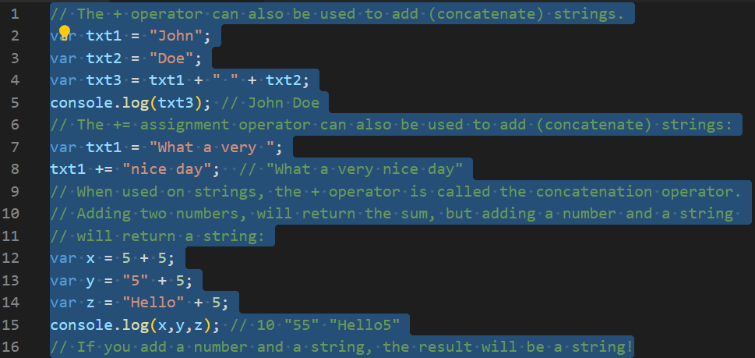
String Operators
Source: https://www.w3schools.com/js/js_operators.asp

Slide 60

Unary, Binary and Ternary Operators
Source: https://developer.mozilla.org/en-US/docs/Web/JavaScript/Guide/Expressions_and_Operators

Slide 61

Unary Operators: Void Operator
Source: speakingjs.com/es5/ch09.html#_special_operators

Slide 62

Unary Operators: Typeof Operator
Typeof operator always returns a string (containing the type of the operand).
The data type of NaN is number
The data type of an array is object
The data type of a date is object
The data type of null is object
The data type of an undefined variable is undefined and a variable that has not been assigned a value is also undefined.
You cannot use typeof to determine if a JavaScript object is an array (or a date).
Source: https://www.w3schools.com/js/js_type_conversion.asp

Slide 63

Comma Operator and Conditional (Ternary) Operator ( ? : )
Source: http://speakingjs.com/es5/ch09.html#_special_operators

Slide 64

Relational Operators: Instanceof
Source: https://developer.mozilla.org/en-US/docs/Web/JavaScript/Reference/Operators/instanceof

Slide 65

Throw Errors
When an error occurs, JavaScript will normally stop and generate an error message. The technical term for this is: JavaScript will throw an exception (throw an error).
JavaScript will actually create an Error object with two properties: name and message.
The throw Statement:
The throw statement allows you to create a custom error.
Technically you can throw an exception (throw an error).
The exception can be a JavaScript String, a Number, a Boolean or an Object:
The console.error() method writes an error message to the console. The console is useful for testing purposes.
Sources: https://www.w3schools.com/js/js_errors.asp and https://www.w3schools.com/Jsref/met_console_error.asp

Slide 66
Errors
JavaScript has a built in error object that provides error information when an error occurs. The error object provides two useful properties: name and message. Six different values can be returned by the error name property.
Source: https://www.w3schools.com/js/js_errors.asp
Property | Description
name | Sets or returns an error name
message | Sets or returns an error message (a string)
Error Name | Description
EvalError | An error has occurred in the eval() function
RangeError | A number "out of range" has occurred
ReferenceError | An illegal reference has occurred
SyntaxError | A syntax error has occurred
TypeError | A type error has occurred
URIError | An error in encodeURI() has occurred

Slide 67
Errors: Try Catch statement
The try statement consists of a try-block, which contains one or more statements. {} must always be used, even for single statements. At least one catch-block, or a finally-block, must be present. This gives us three forms for the try statement:
try...catch
try...finally
try...catch...finally
A catch-block contains statements that specify what to do if an exception is thrown in the try-block. If any statement within the try-block (or in a function called from within the try-block) throws an exception, control is immediately shifted to the catch-block.
If no exception is thrown in the try-block, the catch-block is skipped.
The finally-block will always execute after the try-block and catch-block(s) have finished executing. It always executes, regardless of whether an exception was thrown or caught.
You can nest one or more try statements. If an inner try statement does not have a catch-block, the enclosing try statement's catch-block is used instead.
You can also use the try statement to handle JavaScript exception.
Source: https://developer.mozilla.org/en-US/docs/Web/JavaScript/Reference/Statements/try...catch

Slide 68

Errors: Try Catch statement
Nested try-blocks
Any given exception will be caught only once by the nearest enclosing catch-block unless it is rethrown.
Of course, any new exceptions raised in the "inner" block (because the code in catch-block may do something that throws), will be caught by the "outer" block.
Note! A constructor Error with new keyword is used on the line 3.
Source: https://developer.mozilla.org/en-US/docs/Web/JavaScript/Reference/Statements/try...catch

Slide 69

Range and Reference Errors
Source: https://www.w3schools.com/js/js_errors.asp

Slide 70

Syntax and Type errors
Source: https://www.w3schools.com/js/js_errors.asp

Slide 71

URI and Eval Errors
Warning ! eval() is a dangerous function, which executes the code it's passed with the privileges of the caller. If you run eval() with a string that could be affected by a malicious party, you may end up running malicious code on the user's machine with the permissions of your webpage / extension.
The eval() function evaluates JavaScript code represented as a string. Executing JavaScript from a string is an enormous security risk. It is far too easy for a bad actor to run arbitrary code when you use eval(). More importantly, a third-party code can see the scope in which eval() was invoked, which can lead to possible attacks in ways to which the similar Function is not susceptible.
Sources: https://www.w3schools.com/js/js_errors.asp and https://developer.mozilla.org/en-US/docs/Web/JavaScript/Reference/Global_Objects/eval

Slide 72

URI(Identifier): URL(Location) URN(Name)
URL - Uniform Resource Locator
Web browsers request pages from web servers by using a URL.
The URL is the address of a web page, like: https://www.w3schools.com.
URL Encoding (Percent Encoding)
URLs can only be sent over the Internet using the ASCII character-set.
Since URLs often contain characters outside the ASCII set, the URL has to be converted into a valid ASCII format.
URL encoding replaces unsafe ASCII characters with a "%" followed by two hexadecimal digits.
URLs cannot contain spaces. URL encoding normally replaces a space with a plus (+) sign or with %20.
Uniform Resource Identifier (URI)
A Uniform Resource Identifier (URI) is a string of characters which identifies an Internet Resource.
The most common URI is the Uniform Resource Locator (URL) which identifies an Internet domain address. Another, not so common type of URI is the Uniform Resource Name (URN).
Sources: https://www.w3schools.com/tags/ref_urlencode.ASP, https://www.w3schools.com/xml/xml_namespaces.asp and https://en.wikipedia.org/wiki/Uniform_Resource_Identifier#examples

Slide 73

EncodeURIComponent() and DecodeURIComponent()
ASCII Encoding Reference
ASCII Encoding Reference : Your browser will encode input, according to the character-set used in your page. The default character-set in HTML5 is UTF-8. The table below includes three first encodings.
Sources: https://www.w3schools.com/jsref/jsref_encodeuricomponent.asp, https://www.w3schools.com/jsref/jsref_decodeuricomponent.asp and https://www.w3schools.com/tags/ref_urlencode.ASP
Character | From Windows-1252 | From UTF-8
space | %20 | %20
! | %21 | %21
" | %22 | %22

Slide 74

Javacript Engine
Engine: responsible for start-to-finish compilation and execution of our JavaScript program.
Compiler: handles all the dirty work of parsing and code-generation.
Scope Manager: collects and maintains a lookup list of all the declared variables/identifiers and enforces a set of rules as to how these are accessible to currently executing code.
var students = [ .. ] has a declaration and initialization-assignment parts.
We typically think of that as a single statement, but that's not how Engine sees it. In fact, JS treats these as two distinct operations, one which Compiler will handle during compilation, and the other which Engine will handle during execution.
Source: https://github.com/getify/You-Dont-Know-JS/blob/2nd-ed/scope-closures/ch2.md

Slide 75
Javascript Compiler
Processing of JS programs occurs in two phases: parsing/compilation first, then execution. (Code is first parsed [possibly to global memory/scope] and then executed [accessing global memory/scope if needed]).
Note! Hoisting is done during parsing phase.
Source: https://github.com/getify/You-Dont-Know-JS/blob/2nd-ed/scope-closures/ch1.md
Other than declarations, all occurrences of variables/identifiers in a program serve in one of two "roles": either they're the target of an assignment or they're the source of a value.
The terms "LHS" (aka, target) and "RHS" (aka, source) are used for these roles, respectively. As you might guess from the "L" and the "R", the acronyms mean "Left-Hand Side" and "Right-Hand Side", as in left and right sides of an = assignment operator.
However, assignment targets and sources don't always literally appear on the left or right of an = , so it's probably clearer to think in terms of target / source rather than left / right.

Slide 76
Javacript Scope Manager
Bubble 1 (RED) encompasses the global scope, which holds three identifiers/variables: students (line 1), getStudentName (line 8), and nextStudent (line 16).
Bubble 2 (BLUE) encompasses the scope of the function getStudentName(..) (line 8), which holds just one identifier/variable: the parameter studentID (line 8).
Bubble 3 (GREEN) encompasses the scope of the for-loop (line 9), which holds just one identifier/variable: student (line 9).
Scope bubbles are determined during compilation based on where the functions/blocks of scope are written, the nesting inside each other, and so on. Each scope bubble is entirely contained within its parent scope bubble. A scope is never partially in two different outer scopes.
Source: https://github.com/getify/You-Dont-Know-JS/blob/2nd-ed/scope-closures/ch2.md

Slide 77
Lexical Scope
We've demonstrated that JS's scope is determined at compile time; the term for this kind of scope is "lexical scope". "Lexical" is associated with the "lexing" stage of compilation.
The key idea of "lexical scope" is that it's controlled entirely by the placement of functions, blocks, and variable declarations, in relation to one another.
If you place a variable declaration inside a function, the compiler handles this declaration as it's parsing the function and associates that declaration with the function's scope. If a variable is block-scope declared (let / const), then it's associated with the nearest enclosing { .. } block, rather than its enclosing function (as with var).
A reference (target or source role) for a variable must be resolved as coming from one of the scopes that are lexically available to it; otherwise the variable is said to be "undeclared“.
If the variable is not declared in the current scope, the next outer/enclosing scope will be consulted.
This process of stepping out one level of scope nesting continues until either a matching variable declaration can be found, or the global scope is reached.
Compilation doesn't do anything in terms of reserving memory for scopes and variables. None of the program has been executed yet.
Compilation creates a map of all the lexical scopes that lays out what the program will need while it executes.
While scopes are identified during compilation, they're not actually created until runtime, each time a scope needs to run.
Source: https://github.com/getify/You-Dont-Know-JS/blob/2nd-ed/scope-closures/ch1.md

Slide 78
Global Scope
The global scope is where JS exposes its built-ins:
primitives: undefined, null, Infinity, NaN
natives: Date(), Object(), String(), etc.
global functions: eval(), parseInt(), etc.
namespaces: Math, Atomics, JSON
friends of JS: Intl, WebAssembly
The environment hosting the JS engine exposes its own built-ins:
console (and its methods)
the DOM (window, document, etc)
timers (setTimeout(..), etc)
web platform APIs: navigator, history, geolocation, WebRTC, etc.
The global scope is the “outermost” scope – it has no outer scope. Its environment is the global environment. Every environment is connected with the global environment via a chain of environments that are linked by outer environment references.
Different JS environments handle the scopes of your programs, especially the global scope, differently.
In a programming environment, the global scope is the scope that contains, and is visible in, all other scopes.
In client-side JavaScript, the global scope is generally the web page inside which all the code is being executed.
Sources: https://github.com/getify/You-Dont-Know-JS/blob/2nd-ed/scope-closures/ch4.md, https://exploringjs.com/deep-js/ch_global-scope.html and https://developer.mozilla.org/en-US/docs/Glossary/Global_scope

Slide 79

Variables
The names of variables, called identifiers, conform to certain rules.
A JavaScript identifier must start with a letter, underscore (_), or dollar sign ($). Subsequent characters can also be digits (0–9).
Because JavaScript is case sensitive, letters include the characters "A" through "Z" (uppercase) as well as "a" through "z" (lowercase).
Source: https://developer.mozilla.org/enUS/docs/Web/JavaScript/Guide/Grammar_and_Types#Variables
Some examples of legal names are Number_hits, temp99, $credit, and _name.
A variable declared using the var or let statement with no assigned value specified has the value of undefined.
An attempt to access an undeclared variable results in a ReferenceError exception being thrown.

Slide 80

Initializing a Variable
Once you've declared a variable, you can initialize it with a value. You do this by typing the variable name, followed by an equals sign (=), followed by the value you want to give it.
In JavaScript, all code instructions should end with a semi-colon (;) . If you forget a semi-colon the ASI will add it.
A variable is a container for a value. But one special thing about variables is that their contained values can change.
Variables can also contain strings, numbers, complex data and even entire functions.
Variables aren't the values themselves; they are containers for values. Don't confuse a variable that exists but has not defined value with a variable that doesn't exist at all.
Source: https://developer.mozilla.org/en-US/docs/Learn/JavaScript/First_steps/Variables

Slide 81

JavaScript Primitive versus Reference Values
In JavaScript, a variable may store two types of values: primitive and reference.
JavaScript provides six primitive types as undefined, null, boolean, number, string, and symbol , and a reference type object.
The size of a primitive value is fixed, therefore, JavaScript stores the primitive value on the stack.
On the other hand, the size of a reference value is dynamic so JavaScript stores the reference value on the heap.
When you assign a value to a variable, the JavaScript engine will determine whether the value is a primitive or reference value.
Source: https://www.javascripttutorial.net/javascript-primitive-vs-reference-values/
If the value is a primitive value, when you access the variable, you manipulate the actual value stored in that variable. In other words, the variable that stores a primitive value is accessed by value.
Unlike a primitive value, when you manipulate an object, you work on the reference of that object, rather than the actual object. It means a variable that stores an object is accessed by reference.

Slide 82




JavaScript Primitive versus Reference Values
Copying primitive values: When you assign a variable that stores a primitive value to another, the value stored in the variable is created and copied into the new variable.
Source: https://www.javascripttutorial.net/javascript-primitive-vs-reference-values/

Slide 83


JavaScript Primitive versus Reference Values
Copying reference values:
When you assign a reference value from one variable to another, the value stored in the variable is also copied into the location of the new variable.
The difference is that the values stored in both variables now are the address of the actual object stored on the heap. As a result, both variables are referencing the same object.
Source: https://www.javascripttutorial.net/javascript-primitive-vs-reference-values/

Slide 84


JavaScript Primitive versus Reference Values
Javascript is always pass by value, but when a variable refers to an object (including arrays), the "value" is a reference to the object. Changing the value of a variable never changes the underlying primitive or object, it just points the variable to a new primitive or object. However, changing a property of an object referenced by a variable does change the underlying object.
Sources: https://www.javascripttutorial.net/javascript-primitive-vs-reference-values/ and https://stackoverflow.com/questions/6605640/javascript-by-reference-vs-by-value

Slide 85

Hoisting
Source: https://www.w3schools.com/js/js_hoisting.asp

Slide 86


Variable Hoisting
The variable and function declarations are put into memory during the compile phase, but stay exactly where you typed them in your code. JavaScript only hoists declarations, not initializations.
Source: https://developer.mozilla.org/en-US/docs/Glossary/Hoisting

Slide 87

Using Variables : Var, Let and Const
Values can be held in variables; think of variables as just containers for values. Variables have to be declared (created) to be used.
The let keyword has some differences to var, with the most obvious being that let allows a more limited access to the variable than var. This is called "block scoping" as opposed to regular or function scoping.
The attempt to access age outside of the if statement results in an error, because age was “block-scoped” to the if, whereas myName was not.
A third declaration form is const. It's like let but has an additional limitation that it must be given a value at the moment it's declared, and const cannot be re-assigned a different value later.
Source: https://github.com/getify/You-Dont-Know-JS/blob/2nd-ed/get-started/ch2.md

Slide 88

The difference between Var and Let
Back when JavaScript was first created, there was only var.
Let and const were created in modern versions of JavaScript.
If you write a multiline JavaScript program that declares and initializes a variable, you can actually declare a variable with var after you initialize it and it will still work.
This works because of hoisting.
Hoisting no longer works with let. If we changed var to let in the example, it would fail with an error. This is a good thing.
Source: https://developer.mozilla.org/en-US/docs/Learn/JavaScript/First_steps/Variables

Slide 89

The difference between Var, Let and Const
When you use var, you can declare the same variable as many times as you like (lines 1 and 2)
With let you can not declare the value again, but you can give it a new value (lines 9 and 10)
Const works in exactly the same way as let, except that you can not give a const a new value (lines 13 and 14)
For these reasons and more, it is recommended that you use let and const as much as possible in your code, rather than var.
Source: https://developer.mozilla.org/en-US/docs/Learn/JavaScript/First_steps/Variables

Slide 90
Statements
A computer program is a list of "instructions" to be "executed" by a computer.
In a programming language, these programming instructions are called statements.
A JavaScript program is a list of programming statements.
The statements are executed, one by one (synchronously), in the same order as they are written.
JavaScript statements are composed of:
Values, Operators, Expressions, Keywords, and Comments.
Source: https://www.w3schools.com/js/js_statements.asp
Semicolons separate JavaScript statements.
Add a semicolon at the end of each executable statement (not required, but highly recommended).
JavaScript ignores multiple spaces. You can add white space to your script to make it more readable.
A good practice is to put spaces around operators ( = + - * / ).
JavaScript statements can be grouped together in code blocks, inside curly brackets {...}.
The purpose of code blocks is to define statements to be executed together.
JavaScript keywords are reserved words. Reserved words cannot be used as names for variables or functions.

Slide 91
Variables, Literals, Expressions, Identifiers and Keywords
The JavaScript syntax defines two types of values: fixed values and variable values.
Fixed values are called literals.
Variable values are called variables.
An expression is a combination of values, variables, and operators, which computes to a value.
The computation is called an evaluation.
The values can be of various types, such as numbers and strings.
Source: https://www.w3schools.com/js/js_syntax.asp
Identifiers are names. Identifiers are used to name variables (keywords, functions, and labels).
Any JavaScript identifier that is not a reserved keyword is a label.
JavaScript keywords are used to identify actions to be performed. (var, let and const are among reserved keywords)
Lower Camel Case:
JavaScript programmers tend to use camel case that starts with a lowercase letter:
firstName, lastName, masterCard, interCity.

Slide 92

Variables, Literals, Expressions, Identifiers and Keywords
Source: https://www.w3schools.com/js/js_syntax.asp

Slide 93
Data Types
In JavaScript there are 5 different data types that can contain values:
string
number
boolean
object
function
There are 2 data types that cannot contain values:
null
undefined
There are 6 types of objects:
Object
Date
Array
String
Number
Boolean
Source: https://www.w3schools.com/js/js_type_conversion.asp

Slide 94

Value Type Determination
Unit of information in a program is a value. Values are data. They're how the program maintains state.
Values come in two forms in Javascript:
primitive or object
Functions, like arrays, are a special kind (aka, sub-type) of object.
Primitive values and object values behave differently when they're assigned or passed around.
For distinguishing values, the typeof operator tells you its built-in type, if primitive, or "object“.
Source: https://github.com/getify/You-Dont-Know-JS/blob/2nd-ed/get-started/ch2.md
WARNING !
Typeof null unfortunately returns "object" instead of the expected "null".
Typeof returns the specific "function" for functions, but not the expected "array" for arrays.

Slide 95
Primitive Data Types
A primitive (primitive value, primitive data type) is data that is not an object and has no methods.
There are 6 primitive data types:
string
number
bigint
boolean
undefined
symbol (new in ECMAScript 2015)
There also is null, which is seemingly primitive, but indeed is a special case for every Object.
JavaScript has dynamic types. This means that the same variable can be used to hold different data types.
It is important not to confuse a primitive itself with a variable assigned a primitive value.
All primitives are immutable and cannot be directly altered. Instead of working primitives directly, we're working on a replaced copy, without affecting the original.
The variable may be reassigned a new value, but the existing value can not be changed in the ways that objects, arrays, and functions can be altered.
Source: https://developer.mozilla.org/en-US/docs/Glossary/Primitive

Slide 96
Eight Data Types
There is seven data types that are primitives and an Object:
Boolean True and false.
Undefined A top-level property whose value is not defined.
Number An integer or floating point number. For example: 42 (integer) or 3.14159 (floating point).
BigInt An integer with arbitrary precision. For example: 9007199254740992n.
Source: https://developer.mozilla.org/en-US/docs/Web/JavaScript/Guide/Grammar_and_types
String A sequence of characters that represent a text value. For example: "Howdy"
Symbol (new in ECMAScript 2015) A data type whose instances are unique and immutable.
Null A special keyword denoting a null value.
Object including:
Object
Date
Array
String
Number
Boolean

Slide 97

Undefined and Null
Source: http://speakingjs.com/es5/ch01.html

Slide 98

Strings
Strings are useful for holding data that can be represented in text form. A JavaScript string is zero or more characters written inside quotes. String Methods and String Properties: Primitive values, like "John Doe", cannot have properties or methods (because they are not objects).
But with JavaScript, methods and properties are also available to primitive values, because JavaScript treats primitive values as objects when executing methods and properties. Strings can also be defined as objects with the keyword new. WARNING ! Don't create strings as objects. It slows down execution speed.
Sources: https://developer.mozilla.org/en-US/docs/Web/JavaScript/Reference/Global_Objects/String and https://www.w3schools.com/js/js_strings.asp

Slide 99

String Methods and Properties
All string methods return a new string. They don't modify the original string. Formally said: strings are immutable: strings cannot be changed, only replaced.
Source: https://www.w3schools.com/js/js_string_methods.asp

Slide 100

Converting a String to an Array
Source: https://www.w3schools.com/js/js_string_methods.asp

Slide 101

Template Literals (Template Strings)
Template literals are string literals allowing embedded expressions. You can use multi-line strings and string interpolation features with them.
They were called "template strings" in prior editions of the ES2015 specification.
Template literals are enclosed by the backtick (` `) (grave accent) character instead of double or single quotes.
Template literals can contain placeholders. These are indicated by the dollar sign and curly braces (${expression}). The expressions in the placeholders and the text between the backticks (` `) get passed to a function.
Source: https://developer.mozilla.org/en-US/docs/Web/JavaScript/Reference/Template_literals
The default function just concatenates the parts into a single string. If there is an expression preceding the template literal (tag here), this is called a tagged template. In that case, the tag expression (usually a function) gets called with the template literal, which you can then manipulate before outputting.

Slide 102

Template Literals (Template Strings) 2
Source: https://developer.mozilla.org/en-US/docs/Web/JavaScript/Reference/Template_literals

Slide 103

Template Literals (Template Strings) 3
Source: https://developer.mozilla.org/en-US/docs/Web/JavaScript/Reference/Template_literals

Slide 104

Template Literals (Template Strings) 4
Source: https://developer.mozilla.org/en-US/docs/Web/JavaScript/Reference/Template_literals

Slide 105

Template Literals (Template Strings) 5
Source: https://developer.mozilla.org/en-US/docs/Web/JavaScript/Reference/Template_literals

Slide 106

Numbers
JavaScript numbers are always 64-bit floating point. JavaScript numbers are always stored as double precision floating point numbers, following the international IEEE 754 standard.
Source: https://www.w3schools.com/js/js_numbers.asp

Slide 107

Base Systems of Numbers
WARNING ! Never write a number with a leading zero (like 07). Some JavaScript versions interpret numbers as octal if they are written with a leading zero. Octal number syntax uses a leading zero.
Source: https://www.w3schools.com/js/js_numbers.asp

Slide 108

Numbers: NaN
The global NaN property is a value representing Not-A-Number. NaN is a property of the global object.
The initial value of NaN is Not-A-Number — the same as the value of Number.NaN. In modern browsers, NaN is a non-configurable, non-writable property. Even when this is not the case, avoid overriding it.
It is rather rare to use NaN in a program. It is the returned value when Math functions fail (Math.sqrt(-1)) or when a function trying to parse a number fails (parseInt("blabla")).
Source: https://developer.mozilla.org/en-US/docs/Web/JavaScript/Reference/Global_Objects/NaN

Slide 109

Numbers: NaN
Source: https://developer.mozilla.org/en-US/docs/Web/JavaScript/Reference/Global_Objects/NaN

Slide 110

Regular Expressions
A regular expression is a sequence of characters that forms a search pattern. The search pattern can be used for text search and text replace operations. Syntax: /pattern/modifiers;
In JavaScript, regular expressions are also objects.
These patterns are used with the exec() and test() methods of RegExp, and with the match(), matchAll(), replace(), search(), and split() methods of String.
Parentheses around any part of the regular expression pattern “/d(b+)d/g ”causes that part of the matched substring to be remembered. Once remembered, the substring can be recalled for other use.
Sources: https://www.w3schools.com/js/js_regexp.asp and https://developer.mozilla.org/enUS/docs/Web/JavaScript/Guide/Regular_Expressions

Slide 111
Regular Expressions 2
Methods that use regular expressions:
Source: https://www.w3schools.com/js/js_regexp.asp
Method | Description
exec() | Executes a search for a match in a string. It returns an array of information or null on a mismatch.
test() | Tests for a match in a string. It returns true or false.
match() | Returns an array containing all of the matches, including capturing groups, or null if no match is found.
matchAll() | Returns an iterator containing all of the matches, including capturing groups.
search() | Tests for a match in a string. It returns the index of the match, or -1 if the search fails.
replace() | Executes a search for a match in a string and replaces the matched substring with a replacement substring.
split() | Uses a regular expression or a fixed string to break a string into an array of substrings.

Slide 112
Regular Expressions 3
Special characters in regular expressions and regular expression flags:
When the search for a match requires something more than a direct match, such as finding one or more b's, or finding white space, you can include special characters in the pattern. For example, to match a single "a" followed by zero or more "b"s followed by "c", you'd use the pattern /ab*c/: the * after "b" means "0 or more occurrences of the preceding item." In the string "cbbabbbbcdebc", this pattern will match the substring "abbbbc". If you need to use any of the special characters literally (actually searching for a "*", for instance), you must escape it by putting a backslash in front of it.
Source: https://developer.mozilla.org/en-US/docs/Web/JavaScript/Guide/Regular_Expressions
Characters / constructs | Corresponding article
\, ., \cX, \d, \D, \f, \n, \r, \s, \S, \t, \v, \w, \W, \0, \xhh, \uhhhh, \uhhhhh, [\b] | Character classes
^, $, x(?=y), x(?!y), (?<=y)x, (?<!y)x, \b, \B | Assertions
(x), (?:x), x|y, [xyz], [^xyz], \Number | Groups and ranges
*, +, ?, x{n}, x{n,}, x{n,m} | Quantifiers
\p{UnicodeProperty}, \P{UnicodeProperty} | Unicode property escapes

Slide 113
Regular Expressions 4
Flag | Description | Corresponding property
g | Global search. | RegExp.prototype.global
i | Case-insensitive search. | RegExp.prototype.ignoreCase
m | Multi-line search. | RegExp.prototype.multiline
s | Allows . to match newline characters. (Added in ES2018, not yet supported in Firefox). | RegExp.prototype.dotAll
u | "unicode"; treat a pattern as a sequence of unicode code points. | RegExp.prototype.unicode
y | Perform a "sticky" search that matches starting at the current position in the target string. See sticky. | RegExp.prototype.sticky
Regular expressions have six optional flags that allow for functionality like global and case insensitive searching. These flags can be used separately or together in any order and are included as part of the regular expression. To include a flag with the regular expression, use this syntax: var re = /pattern/flags; or var re = new RegExp('pattern', 'flags’); Note that the flags are an integral part of a regular expression. They cannot be added or removed later.
Source: https://developer.mozilla.org/en-US/docs/Web/JavaScript/Guide/Regular_Expressions

Slide 114

Booleans
A JavaScript Boolean represents one of two values: true or false.
Very often, in programming, you will need a data type that can only have one of two values, like
YES / NO
ON / OFF
TRUE / FALSE
Boolean conditionals true and false are often used to decide which sections of code to execute (such as in if statements) or repeat (such as in for loops).
The Boolean value is named after English mathematician George Boole, who pioneered the field of mathematical logic.
The Boolean value of an expression is the basis for all JavaScript comparisons and conditions.
Sources: https://www.w3schools.com/js/js_booleans.asp and https://developer.mozilla.org/en-US/docs/Glossary/Boolean

Slide 115

Booleans
Source: https://www.w3schools.com/js/js_booleans.asp

Slide 116
Booleans: Truthy and Falsy
Whenever JavaScript expects a boolean value (e.g., for the condition of an if statement), any value can be used. It will be interpreted as either true or false. The following values are interpreted as false:
undefined, null
Boolean: false
Number: 0, NaN
String: ‘’
All other values (including all objects!) are considered true. Values interpreted as false are called falsy, and values interpreted as true are called truthy. Boolean(), called as a function, converts its parameter to a boolean.
The primitive boolean type comprises the values true and false. The following operators produce booleans:
Binary logical operators: && (And), || (Or)
Prefix logical operator: ! (Not)
Comparison operators:
Equality operators: ===, !==, ==, !=
Ordering operators (for strings and numbers): >, >=, <, <=
Sources: http://speakingjs.com/es5/ch01.html#basic_truthy_falsy and http://speakingjs.com/es5/ch01.html

Slide 117

Symbol
Symbols are guaranteed to be unique. Even if we create many symbols with the same description, they are different values. A symbol may be used as an object property.
Source: https://developer.mozilla.org/en-US/docs/Glossary/Symbol

Slide 118

Symbol 2
Source: https://exploringjs.com/es6/ch_symbols.html#sec_overview-symbols

Slide 119

The Typeof Operator
You can use the typeof operator to find the data type of a JavaScript variable. You cannot use typeof to determine if a JavaScript object is an array (or a date). Typeof operator always returns a string (containing the type of the operand).
The data type of an undefined variable is undefined. The data type of a variable that has not been assigned a value is also undefined.
Source: https://www.w3schools.com/js/js_type_conversion.asp

Slide 120

Type Conversion
JavaScript variables can be converted to a new variable and another data type.
By the use of a JavaScript function. (Implicit or explicit conversion). Number() converts to a Number, String() converts to a String, Boolean() converts to a Boolean.
Automatically by JavaScript itself. (Implicit coercion)
When JavaScript tries to operate on a "wrong" data type, it will try to convert the value to a "right" data type.
The result is not always what you expect:
Source: https://www.w3schools.com/js/js_type_conversion.asp

Slide 121

Type Conversion versus Type Coersion
Type coercion is the automatic or implicit conversion of values from one data type to another (such as strings to numbers).
Type conversion is similar to type coercion because they both convert values from one data type to another with one key difference: type coercion is implicit whereas type conversion can be either implicit or explicit.
Sources: https://developer.mozilla.org/en-US/docs/Glossary/Type_coercion and https://www.w3schools.com/js/js_type_conversion.asp

Slide 122
Type Conversion
Note! Red values indicate values with unexpected results.
Source: https://www.w3schools.com/js/js_type_conversion.asp
Original Value | Converted to Number | Converted to String | Converted to Boolean
false | 0 | "false" | false
true | 1 | "true" | true
0 | 0 | "0" | false
1 | 1 | "1" | true
"0" | 0 | "0" | true
"000" | 0 | "000" | true
"1" | 1 | "1" | true
NaN | NaN | "NaN" | false
Infinity | Infinity | "Infinity" | true
-Infinity | -Infinity | "-Infinity" | true
"" | 0 | "" | false
Original Value | Converted to Number | Converted to String | Converted to Boolean
"20" | 20 | "20" | true
"twenty" | NaN | "twenty" | true
[ ] | 0 | "" | true
[20] | 20 | "20" | true
[10,20] | NaN | "10,20" | true
["twenty"] | NaN | "twenty" | true
["ten","twenty"] | NaN | "ten,twenty" | true
function(){} | NaN | "function(){}" | true
{ } | NaN | "[object Object]" | true
null | 0 | "null" | false
undefined | NaN | "undefined" | false

Slide 123

Automatic String Conversion
JavaScript type conversion: JavaScript variables can be converted to a new variable and another data type: By the use of a JavaScript function or automatically by JavaScript itself.
Source: https://www.w3schools.com/js/js_type_conversion.asp

Slide 124
Strict Mode
JavaScript was designed to be easy for novice developers and that is why default mode, non-strict mode is referred to as "sloppy mode". This isn't an official term.
Strict mode is declared by adding "use strict"; to the beginning of a script or a function.
Declared at the beginning of a script, it has global scope (all code in the script will execute in strict mode).
Declared inside a function, it has local scope (only the code inside the function is in strict mode).
Strict mode makes several changes to normal JavaScript semantics.
Sources: https://www.w3schools.com/js/js_strict.asp and https://developer.mozilla.org/en-US/docs/Web/JavaScript/Reference/Strict_mode
Eliminates some JavaScript silent errors by changing them to throw errors.
Fixes mistakes that make it difficult for JavaScript engines to perform optimizations: strict mode code can sometimes be made to run faster than identical code that's not strict mode.
Prohibits some syntax likely to be defined in future versions of ECMAScript.
Strict mode code and non-strict mode code can coexist, so scripts can opt into strict mode incrementally.
Strict mode helps you to write cleaner code.
Strict mode changes previously accepted "bad syntax" into real errors.
With strict mode it is impossible to accidentally create a global variable.

Slide 125

Strict Mode 2
Source: https://www.w3schools.com/js/js_strict.asp

Slide 126

Strict Mode 3
Source: https://www.w3schools.com/js/js_strict.asp

Slide 127

This Keyword
The JavaScript this keyword refers to the object it belongs to.
It has different values depending on where it is used:
In a method, this refers to the owner object.
Alone, this refers to the global object.
In a function, this refers to the global object.
In a function, in strict mode, this is undefined.
In an event, this refers to the element that received the event.
Methods like call(), apply() and bind() can refer this to any object.
Source: https://www.w3schools.com/js/js_this.asp

Slide 128

This Keyword 2
Source: https://www.w3schools.com/js/js_this.asp

Slide 129

This Keyword 3
Source: https://www.w3schools.com/js/js_this.asp

Slide 130


This Keyword 4
Source: https://www.w3schools.com/js/js_this.asp and https://www.w3schools.com/jsref/prop_style_display.asp
In HTML event handlers, this refers to the HTML element that received the event which is button in this case.
Elements in HTML are mostly "inline" or "block" elements: An inline element has floating content on its left and right side. A block element fills the entire line, and nothing can be displayed on its left or right side. If you set display:none, it hides the entire element, while visibility:hidden means that the contents of the element will be invisible, but the element stays in its original position and size.

Slide 131



This Keyword 5
Source: https://www.w3schools.com/js/js_arrow_function.asp

Slide 132

This Keyword with Call() and Apply()
The JavaScript call() method: The call() method is a predefined JavaScript method. It can be used to invoke (call) a method with an owner object as an argument (parameter).
With call(), an object can use a method belonging to another object.
Sources: https://www.w3schools.com/js/js_this.asp and https://www.w3schools.com/js/js_function_call.asp

Slide 133

This Keyword with Call() and Apply()
Source: https://www.w3schools.com/js/js_function_apply.asp

Slide 134

This Keyword with Bind()
The bind() method creates a new function that, when called, has its this keyword set to the provided value, with a given sequence of arguments preceding any provided when the new function is called.
Sources: https://developer.mozilla.org/en-US/docs/Web/JavaScript/Reference/Global_Objects/Function/bind and https://exploringjs.com/es6/ch_arrow-functions.html#sec_arrow-func-vs-bind and …ch_callables.html#sec_iifes-in-es6

Slide 135
Objects
In JavaScript, almost "everything" is an object.
Booleans can be objects (if defined with the new keyword)
Numbers can be objects (if defined with the new keyword)
Strings can be objects (if defined with the new keyword)
Dates are always objects
Maths are always objects
Regular expressions are always objects
Arrays are always objects
Functions are always objects
Objects are always objects
All JavaScript values, except primitives, are objects.
Source: https://www.w3schools.com/js/js_object_definition.asp
A primitive value is a value that has no properties or methods.
A primitive data type is data that has a primitive value.
JavaScript defines 6 types of primitive data types:
string
number
boolean
null
undefined
symbol (new in ECMAScript 2015)
Primitive values are immutable (they are hardcoded and therefore cannot be changed).
if x = 3.14, you can change the value of x. But you cannot change the value of 3.14.

Slide 136


Object Methods
Source: https://developer.mozilla.org/en-US/docs/Web/JavaScript/Reference/Global_Objects/Object
WARNING! Object doesn't have a length property. Only string and arrays have a length property. Use Object.keys(object).length to get the length of an object.
Source: https://dev.to/samanthaming/how-to-get-an-object-length-30pd
Note! By expanding the arrow you get more options

Slide 137

Object: Properties and Methods
The name: value pairs in JavaScript objects are called properties:
You define (and create) a JavaScript object with an object literal:
Object literal: var person = { }
Source: https://www.w3schools.com/js/js_objects.asp
Objects can also have methods.
Methods are actions that can be performed on objects.
Methods are stored in properties as function definitions.

Slide 138

Objects
Source: https://www.w3schools.com/js/js_object_display.asp

Slide 139

Objects: Getters and Setters
Source: https://www.w3schools.com/js/js_object_accessors.asp

Slide 140

Objects: Delete and In operators
Source: https://www.w3schools.com/jsref/jsref_operators.asp

Slide 141

Object.entries, Object.keys and Object.values
Source: https://developer.mozilla.org/en-US/docs/Web/JavaScript/Reference/Global_Objects/Object

Slide 142

Destructuring Objects
Source: https://developer.mozilla.org/en-US/docs/Web/JavaScript/Reference/Operators/Destructuring_assignment

Slide 143

Destructuring Objects 2
Source: https://developer.mozilla.org/en-US/docs/Web/JavaScript/Reference/Operators/Destructuring_assignment

Slide 144

Destructuring Objects 3
Source: https://developer.mozilla.org/en-US/docs/Web/JavaScript/Reference/Operators/Destructuring_assignment

Slide 145

Destructuring Objects 4
Source: https://developer.mozilla.org/en-US/docs/Web/JavaScript/Reference/Operators/Destructuring_assignment

Slide 146


Destructuring Objects 5
Source: https://developer.mozilla.org/en-US/docs/Web/JavaScript/Reference/Operators/Destructuring_assignment

Slide 147

Destructuring Objects 6
Source: https://developer.mozilla.org/en-US/docs/Web/JavaScript/Reference/Operators/Destructuring_assignment

Slide 148

Destructuring Objects 7
Source: https://developer.mozilla.org/en-US/docs/Web/JavaScript/Reference/Operators/Destructuring_assignment

Slide 149

Object Constructors
Source: https://www.w3schools.com/js/js_object_constructors.asp

Slide 150

Object Constructors 2
Source: https://www.w3schools.com/js/js_object_constructors.asp

Slide 151

Object Constructors 3
Source: https://www.w3schools.com/js/js_object_constructors.asp

Slide 152

Built-in Object Constructors
Source: https://www.w3schools.com/js/js_object_constructors.asp

Slide 153

Objects: Prototype Inheritance
All JavaScript objects inherit properties and methods from a prototype:
Date objects inherit from Date.prototype
Array objects inherit from Array.prototype
Person objects inherit from Person.prototype
Date objects, Array objects, and Person objects inherit from Object.prototype.
Sometimes you want to add new properties (or methods) to all existing objects of a given type.
Sometimes you want to add new properties (or methods) to an object constructor.
Source: https://www.w3schools.com/js/js_object_prototypes.asp

Slide 154

Inheritance and the Prototype Chain
JavaScript is dynamic and does not provide a class implementation per se (the class keyword is introduced in ES2015, but is syntactical sugar, JavaScript remains prototype-based).
When it comes to inheritance, JavaScript only has one construct: objects. Each object has a private property which holds a link to another object called its prototype. That prototype object has a prototype of its own, and so on until an object is reached with null as its prototype. By definition, null has no prototype, and acts as the final link in this prototype chain.
Nearly all objects in JavaScript are instances of Object which sits on the top of a prototype chain.
While this confusion is often considered to be one of JavaScript's weaknesses, the prototypal inheritance model itself is, in fact, more powerful than the classic model.
Inheriting properties:
JavaScript objects are dynamic "bags" of properties (referred to as own properties). JavaScript objects have a link to a prototype object. When trying to access a property of an object, the property will not only be sought on the object but on the prototype of the object, the prototype of the prototype, and so on until either a property with a matching name is found or the end of the prototype chain is reached.
Source: https://developer.mozilla.org/en-US/docs/Web/JavaScript/Inheritance_and_the_prototype_chain

Slide 155

Inheritance and the Prototype Chain 2
Following the ECMAScript standard, the notation someObject.[[Prototype]] is used to designate the prototype of someObject. Since ECMAScript 2015, the [[Prototype]] is accessed using the accessors Object.getPrototypeOf() and Object.setPrototypeOf(). This is equivalent to the JavaScript property __proto__ which is non-standard but de-facto implemented by many browsers.
It should not be confused with the func.prototype property of functions, which instead specifies the [[Prototype]] to be assigned to all instances of objects created by the given function when used as a constructor. The Object.prototype property represents the Object prototype object.
Source: https://developer.mozilla.org/en-US/docs/Web/JavaScript/Inheritance_and_the_prototype_chain

Slide 156

Inheritance and the Prototype Chain 3
Source: https://developer.mozilla.org/en-US/docs/Learn/JavaScript/Objects/Object_prototypes

Slide 157


Inheritance and the Prototype Chain 4
If you type "person1." into your JavaScript console, you should see the browser try to auto-complete this with the member names available on this object:
Source: https://developer.mozilla.org/en-US/docs/Learn/JavaScript/Objects/Object_prototypes

Slide 158
Inheritance and the Prototype Chain 5
Understanding prototype objects:
Here we'll go back to the example in which we finished writing our Person() constructor .
If you type "person1." into your JavaScript console, you should see the browser try to auto-complete this with the member names available on this object:
In this list, you will see the members defined on person1's constructor — Person() — name, age, gender and interests. You will however also see some other members — toString, valueOf, etc — these are defined on Person() 's constructor's prototype object, which is Object.
Source: https://developer.mozilla.org/en-US/docs/Learn/JavaScript/Objects/Object_prototypes

Slide 159

Inheritance and the Prototype Chain 6
This method — Object.valueOf() is inherited by person1 because its constructor is Person(), and Person()'s prototype is Object(). valueOf() returns the value of the object it is called on — try it and see! In this case, what happens is:
The browser initially checks to see if the person1 object has a valueOf() method available on it, as defined on its constructor, Person().
It doesn't, so the browser then checks to see if the Person() constructor's prototype object (Object()) has a valueOf() method available on it. It does, so it is called, and all is good!
Source: https://developer.mozilla.org/en-US/docs/Learn/JavaScript/Objects/Object_prototypes

Slide 160

Inheritance and the Prototype Chain 7
Source: https://developer.mozilla.org/en-US/docs/Learn/JavaScript/Objects/Object_prototypes

Slide 161

Inheritance and the Prototype Chain 8
Source: https://developer.mozilla.org/en-US/docs/Learn/JavaScript/Objects/Object_prototypes

Slide 162



Inheritance and the Prototype Chain 9
Source: https://developer.mozilla.org/en-US/docs/Learn/JavaScript/Objects/Object_prototypes

Slide 163

Classes
Source: https://www.w3schools.com/js/js_classes.asp

Slide 164

Classes 2
Source: https://www.w3schools.com/js/js_classes.asp

Slide 165

Classes 3
Source: https://www.w3schools.com/js/js_classes.asp

Slide 166

Classes 4
Source: https://www.w3schools.com/js/js_classes.asp

Slide 167


Classes 5
Source: https://www.w3schools.com/js/js_classes.asp

Slide 168

Date Objects
Date objects are static. The computer time is ticking, but date objects are not.
By default, JavaScript will use the browser's time zone and display a date as a full text string.
A JavaScript date is fundamentally specified as the number of milliseconds that have elapsed since midnight on January 1, 1970, UTC (Zero time ). This date and time is the same as the UNIX epoch, which is the predominant base value for computer-recorded date and time values.
Sources: https://www.w3schools.com/js/js_dates and https://developer.mozilla.org/en-US/docs/Web/JavaScript/Reference/Global_Objects/Date

Slide 169

Date Objects 2
Source: https://www.w3schools.com/js/js_date_formats.asp

Slide 170


Object and Array rules
DOT NOTATION . You can use dot with strings
strings
numbers
quotations
weird characters
expressions
Source: https://slides.com/bgando/f2f-final-day-1#/0/1
BRACKETS [ ] You can use brackets with all forms
“quotes required”
“strings”
numbers
variables
“weird characters”
expressions
Source: https://slides.com/bgando/f2f-final-day-1#/0/1

Slide 171

Arrays
An array can hold many values under a single name, and you can access the values by referring to an index number.
Array indexes start with 0.
[0] is the first element. [1] is the second element.
Source: https://www.w3schools.com/js/js_arrays.asp
Arrays are a special type of objects. The typeof operator in JavaScript returns "object" for arrays.
The length property of an array returns the length of an array (the number of array elements).
The length property is always one more than the highest array index.

Slide 172


Array Methods
Source: https://developer.mozilla.org/en-US/docs/Web/JavaScript/Reference/Global_Objects/Array/length
Note! By expanding the arrow you get more options

Slide 173

Array Methods 2
Source: https://developer.mozilla.org/en-US/docs/Web/JavaScript/Reference/Global_Objects/Array

Slide 174

Array Methods 3
Source: https://developer.mozilla.org/en-US/docs/Web/JavaScript/Reference/Global_Objects/Array

Slide 175

Array Methods 4
Source: https://developer.mozilla.org/en-US/docs/Web/JavaScript/Guide/Indexed_collections

Slide 176

Array Methods 5
Source: https://developer.mozilla.org/en-US/docs/Web/JavaScript/Guide/Indexed_collections

Slide 177
Array Methods 6: Array.reduce() and Array.reduceRight()
Both methods reduces the array to a single value.
The reduce() method executes a provided function for each value of the array (from left-to-right). The reduceRight() method executes a provided function for each value of the array (from right-to-left).
The return value of both methods of the function are stored in an accumulator (result/total).
Note! Both methods do not execute the function for array elements without values. Both methods do not change the original array.
Sources: https://developer.mozilla.org/en-US/docs/Web/JavaScript/Reference/Global_Objects/Array/Reduce and https://www.w3schools.com/jsref/jsref_reduce.asp
Parameter | Description
function(total,currentValue, index,arr) or function(Accumulator, Current Value, Current Index, Source Array) | Required. A function to be run for each element in the array. Function arguments:
Argument | Description
Total or Accumulator (acc) | Required. The initialValue, or the previously returned value of the function
CurrentValue or Current Value (cur) | Required. The value of the current element
CurrentIndex or Current Index (idx) | Optional. The array index of the current element
Arr or Source Array (src) | Optional. The array object the current element belongs to
initialValue | Optional. A value to be passed to the function as the initial value

Slide 178

Array Methods 7: Array.reduce() and ReduceRight()
Source: https://www.w3schools.com/jsref/jsref_reduce.asp and https://www.w3schools.com/jsref/jsref_reduceright.asp

Slide 179

Array Methods 8: Array.map() and Array.filter()
Source: https://www.w3schools.com/js/js_array_iteration.asp

Slide 180

Array Methods 9
Source: https://www.w3schools.com/js/js_array_iteration.asp

Slide 181

Array Methods 10
Source: https://www.w3schools.com/js/js_array_iteration.asp

Slide 182

Array: Adding Elements with High Indexes
WARNING ! Adding elements with high indexes can create undefined “empty holes" in an array. When setting a property on a JavaScript array when the property is a valid array index and that index is outside the current bounds of the array, the engine will update the array's length property accordingly:
Sources: https://www.w3schools.com/js/js_arrays.asp and https://developer.mozilla.org/en-US/docs/Web/JavaScript/Reference/Global_Objects/Array

Slide 183

Increasing and Deacreasing the Lenght of an Array
Source: https://developer.mozilla.org/en-US/docs/Web/JavaScript/Reference/Global_Objects/Array
Note! JavaScript arrays are zero-indexed: the first element of an array is at index 0, and the last element is at the index equal to the value of the array's length property minus 1. Using an invalid index number returns undefined. A JavaScript array's length property and numerical properties are connected. Several of the built-in array methods (e.g., join(), slice(), indexOf(), etc.) take into account the value of an array's length property when they're called.

Slide 184

4 Ways to Empty an Array in JavaScript
Source: https://www.javascripttutorial.net/array/4-ways-empty-javascript-array/

Slide 185

Destructuring Arrays
Source: https://developer.mozilla.org/en-US/docs/Web/JavaScript/Reference/Operators/Destructuring_assignment

Slide 186

Destructuring Arrays 2
Source: https://developer.mozilla.org/en-US/docs/Web/JavaScript/Reference/Operators/Destructuring_assignment

Slide 187

Destructuring Arrays 3
Source: https://developer.mozilla.org/en-US/docs/Web/JavaScript/Reference/Operators/Destructuring_assignment

Slide 188

Destructuring Arrays 4
Source: https://developer.mozilla.org/en-US/docs/Web/JavaScript/Reference/Operators/Destructuring_assignment

Slide 189

Destructuring Arrays 5
Source: https://developer.mozilla.org/en-US/docs/Web/JavaScript/Reference/Operators/Destructuring_assignment

Slide 190
Loops and Iteration
A for loop repeats until a specified condition evaluates to false.
The JavaScript for loop is similar to the Java and C for loop.
A for statement looks as follows:
for ([initialExpression]; [condition]; [incrementExpression])
statement
Source: https://developer.mozilla.org/en-US/docs/Web/JavaScript/Guide/Loops_and_iteration
The statements for loops provided in JavaScript are:
for statement
do...while statement
while statement
labeled statement
break statement
continue statement
for...in statement
for...of statement

Slide 191
Loops and Iteration 2
Step 1 When a for loop executes, the following occurs:
The initializing expression initialExpression, if any, is executed.
This expression usually initializes one or more loop counters.
Step 2 The condition expression is evaluated. If the value of condition is true,
the loop statements execute.
If the value of condition is false, the for loop terminates.
(If the condition expression is omitted entirely,
the condition is assumed to be true.)
Step 3 The statement executes. To execute multiple statements, use a block statement ({ ... }) to group those statements.
If present, the update expression incrementExpression is executed.
Step 4 Control returns to Step 2.
Source: https://developer.mozilla.org/en-US/docs/Web/JavaScript/Guide/Loops_and_iteration

Slide 192

For Loop and For In Loop
Source: https://btholt.github.io/intro-to-web-dev-v2/objects-and-arrays

Slide 193

For Of Loops
Source: https://www.w3schools.com/js/js_loop_for.asp

Slide 194

While Loop
Source: https://developer.mozilla.org/en-US/docs/Web/JavaScript/Reference/Statements/while

Slide 195

Do While Loop
Source: https://developer.mozilla.org/en-US/docs/Web/JavaScript/Reference/Statements/do...while

Slide 196
Break and Continue
The break and the continue statements are the only JavaScript statements that can "jump out of" a code block.
A code block is a block of code between { and }.
The continue statement (with or without a label reference) can only be used to skip one loop iteration.
Source: https://www.w3schools.com/js/js_break.asp
The break statement, without a label reference,
can only be used to jump out of a loop or a switch.
With a label reference, the break statement
can be used to jump out of any code block.
To label JavaScript statements you precede the statements with a label name and a colon.
label: statements
break labelname;
continue labelname;

Slide 197


Break and Continue 2
Sources: https://www.w3schools.com/js/js_break.asp and https://btholt.github.io/intro-to-web-dev-v2/objects-and-arrays/

Slide 198

Infinite Loops
Source: https://developer.mozilla.org/en-US/docs/Web/JavaScript/Guide/Loops_and_iteration

Slide 199

Conditionals: If Else and Else If and Switch
Conditional statements are used to perform different actions based on different conditions.
In JavaScript we have the following conditional statements:
Use if to specify a block of code to be executed, if a specified condition is true.
Use else to specify a block of code to be executed, if the same condition is false.
Use else if to specify a new condition to test, if the first condition is false.
Use switch to specify many alternative blocks of code to be executed.
Note! that if is in lowercase letters. Uppercase letters (If or IF) will generate a JavaScript error.
Source: https://www.w3schools.com/js/js_if_else.asp

Slide 200

Switch Statement
The switch statement is used to perform different actions based on different conditions. The switch expression is evaluated once. The value of the expression is compared with the values of each case. If there is a match, the associated block of code is executed. When JavaScript reaches a break keyword, it breaks out of the switch block. This will stop the execution of inside the block.
Sources: https://www.w3schools.com/js/js_switch.asp and https://developer.mozilla.org/en-US/docs/Web/JavaScript/Reference/Statements/switch

Slide 201

Switch Statement 2
If multiple switch cases matches a case value, the first case is selected. If no matching swich cases are found, the program continues to the default label. If no default label is found, the program continues to the statement(s) after the switch. Switch cases use strict comparison (===).
Sources: https://www.w3schools.com/js/js_switch.asp and https://developer.mozilla.org/en-US/docs/Web/JavaScript/Reference/Statements/switch

Slide 202

Functions
A function definition (also called a function declaration, or function statement) consists of the function keyword, followed by:
The name of the function.
A list of parameters to the function, enclosed in parentheses and separated by commas.
The JavaScript statements that define the function, enclosed in curly brackets {...}.
Sources: https://developer.mozilla.org/en-US/docs/Web/JavaScript/Guide/Functions and https://www.w3schools.com/js/js_functions.asp
The code inside the function will execute when "something" invokes (calls) the function:
When an event occurs (when a user clicks a button)
When it is invoked (called) from JavaScript code
Automatically (self invoked)

Slide 203

Anatomy of Functions
Source: https://slides.com/bgando/f2f-final-day-1#/0/1

Slide 204


Terms related to Functions
Sources: https://slides.com/bgando/f2f-final-day-1#/0/1, https://www.w3schools.com/js/js_functions.asp and
https://developer.mozilla.org/en-US/docs/Web/JavaScript/Guide/Expressions_and_Operators
Definitions
Fn Names
Invocations
Arguments
Parameteres
Fn Bodies
Return Values
Side Effects
Example of a function from the previous slide
Example of a Side Effect
Side Effects: An expression is any valid unit of code that resolves to a value. Every syntactically valid expression resolves to some value but conceptually, there are two types of expressions: with side effects (for example: those that assign value to a variable) and those that in some sense evaluate and therefore resolve to a value. The expression x = 7 is an example of the first type. This expression uses the = operator to assign the value seven to the variable x. The expression itself evaluates to seven. The code 3 + 4 is an example of the second expression type. This expression uses the + operator to add three and four together without assigning the result, seven, to a variable.

Slide 205

Higher-order Functions versus First-order Functions
In computer science, a higher-order function is a function that does at least one of the following:
Takes one or more functions as arguments
Returns a function as its result.
All other functions are first-order functions.
Taking an other function as an argument is often referred as a callback function, because it is called back by the higher-order function. This is a concept that Javascript uses a lot.
Sources: https://dev.to/damcosset/higher-order-functions-in-javascript-4j8b and https://en.wikipedia.org/wiki/Higher-order_function
The map function is one of the many higher-order functions built into the language.
Sort, reduce, filter, forEach are other examples of higher-order functions built into the language.
We can create smaller functions that only take care of one piece of logic. Then, we compose more complex functions by using different smaller functions.

Slide 206

Functions: Hoisting
Hoisting is JavaScript's default behavior of moving declarations to the top. Only function declarations are hoisted—but not the function expressions. (the same is with variables)
Sources: https://developer.mozilla.org/en-US/docs/Web/JavaScript/Guide/Grammar_and_types and https://www.w3schools.com/js/js_function_definition.asp
Note! The function on the line 11 is actually an anonymous function (a function without a name). Functions stored in variables do not need function names. They are always invoked (called) using the variable name.

Slide 207

Functions: Return Statement
The return statement ends function execution and specifies a value to be returned to the function caller.
Syntax: return value; If value is omitted, return returns undefined.
Sources: https://www.w3schools.com/jsref/jsref_return.asp and https://developer.mozilla.org/en-US/docs/Web/JavaScript/Reference/Statements/return

Slide 208

Function Invocation
Invoking a JavaScript function. The code inside a function is not executed when the function is defined. The code inside a function is executed when the function is invoked. It is common to use the term "call a function" instead of "invoke a function". It is also common to say "call upon a function", "start a function", or "execute a function".
Source: https://www.w3schools.com/js/js_function_invocation.asp

Slide 209


Functions: Arguments and Parameters
A JavaScript function does not perform any checking on parameter values (arguments).
Function parameters are the names listed in the function definition.
Function arguments are the real values passed to (and received by) the function.
Parameter rules:
JavaScript function definitions do not specify data types for parameters.
JavaScript functions do not perform type checking on the passed arguments.
JavaScript functions do not check the number of arguments received.
Sources: https://www.w3schools.com/js/js_function_parameters.asp and https://developer.mozilla.org/en-US/docs/Web/JavaScript/Guide/Functions

Slide 210

Functions: Arguments and Parameters
Source: http://speakingjs.com/es5/ch01.html

Slide 211

Functions: Default and Rest Parameters
Sources: https://www.w3schools.com/js/js_function_parameters.asp and https://developer.mozilla.org/en-US/docs/Web/JavaScript/Guide/Functions

Slide 212

Functions: Default Parameters and Arity
Source: http://speakingjs.com/es5/ch01.html

Slide 213

Functions: Arguments Object
Source: https://developer.mozilla.org/en-US/docs/Web/JavaScript/Reference/Functions

Slide 214

Functions: Recursion
Source: https://developer.mozilla.org/en-US/docs/Web/JavaScript/Guide/Functions

Slide 215

Funtions: Local and Global Scope
Sources: https://www.w3schools.com/js/js_scope.asp and https://drive.google.com/file/d/18e2nJUf2QC3JZ_3N07vRSy8G8xvvjA1X/view
Note! We keep track of the functions being called in JavaScript with a Call stack. One global execution context, multiple function contexts.

Slide 216

Functions: Local versus Global memory
As soon as we start running our code, we create a global execution context
Thread of execution (parsing and executing the code line after line)
Live memory of variables with data (known as a Global Variable Environment)
When you execute a function you create a new execution context comprising:
1. The thread of execution (we go through the code in the function line by line)
2. A local memory ('Variable environment') where anything defined in the function is stored
Source: https://drive.google.com/file/d/18e2nJUf2QC3JZ_3N07vRSy8G8xvvjA1X/view
1. Javascript executes/compiles (runs) the code:
Global Execution Context and Global Variable Environment Lines 1, 2 and 5 are saved globally.
2. Running/calling/invoking a function:
Local Execution Context and Local Variable Environment Line 6 Local Execution Context is created and when done then popped of the stack.
3. Running/calling/invoking a function:
Local Execution Context and Local Variable Environment Line 7 Another Local Execution Context is created.

Slide 217
Functions: Passed by Value versus Passed by Reference
Arguments are Passed by Value
The parameters, in a function call, are the function's arguments.
JavaScript arguments are passed by value. The function only gets to know the values, not the argument's locations.
If a function changes an argument's value, it does not change the parameter's original value.
Changes to arguments are not visible (reflected) outside the function.
Source: https://www.w3schools.com/js/js_function_parameters.asp
Objects are Passed by Reference
In JavaScript, object references are values.
Because of this, objects will behave like they are passed by reference:
If a function changes an object property, it changes the original value.
Changes to object properties are visible (reflected) outside the function.

Slide 218

Functions: Passed by Value versus Passed by Reference 2
Source: https://developer.mozilla.org/en-US/docs/Web/JavaScript/Guide/Functions

Slide 219
Functions: Closure
Minimize the use of global variables. This includes all data types, objects, and functions. Global variables and functions can be used (and overwritten ) by all scripts in the page (and in the window).
In a web page, global variables belong to the window object. Global variables live until the page is discarded, like when you navigate to another page or close the window.
Use local variables instead and learn how to use closures.
JavaScript variables can belong to the local or global scope. Global variables can be made local (private) with closures.
Local variables have short lives. They are created when the function is invoked and deleted when the function is finished.
A local variable can only be used inside the function where it is defined. It is hidden from other functions and other scripting code.
Global and local variables with the same name are different variables. Modifying one, does not modify the other.
A closure is a function having access to the parent scope, even after the parent function has closed.
JavaScript Nested Functions:
All functions have access to the global scope.
In fact, in JavaScript, all functions have access to the scope "above" them.
JavaScript supports nested functions. Nested functions have access to the scope "above" them.
Sources: https://www.w3schools.com/js/js_best_practices.asp and https://www.w3schools.com/js/js_function_closures.asp

Slide 220

Functions: Closure 2
Source: https://slides.com/bgando/f2f-final-day-2#/

Slide 221


Functions: Closure 3
1. Run parent function and save to a variable. This variable will hold whatever that function RETURNS.
2. Optional: Check what that variable hold as its value. (Hint: It should be the inner function)
3. Run the inner function
Source: https://slides.com/bgando/f2f-final-day-2#/

Slide 222
Arrow Function
An arrow function expression is a syntactically compact alternative to a regular function expression.
It does not own bindings to the this, arguments, super, or new.target keywords.
Arrow function expressions are ill suited as methods, and they cannot be used as constructors.
Since arrow functions do not have their own this, the methods call() and apply() can only pass in parameters. Any this argument is ignored.
An arrow function cannot contain a line break between its parameters and its arrow.
An empty arrow function returns undefined.
Source: https://developer.mozilla.org/en-US/docs/Web/JavaScript/Reference/Functions/Arrow_functions and
What About this keyword?
The handling of this is also different in arrow functions compared to regular functions.
In short, with arrow functions there are no binding of this.
In regular functions the this keyword represented the object that called the function, which could be the window, the document, a button or whatever.
With arrow functions the this keyword always represents the object that defined the arrow function.
Source: https://www.w3schools.com/js/js_arrow_function.asp

Slide 223



Arrow Function with this
~
Source: https://www.w3schools.com/js/js_arrow_function.asp

Slide 224

Arrow Function 2
Sources: https://developer.mozilla.org/en-US/docs/Web/JavaScript/Reference/Functions/Arrow_functions and https://www.w3schools.com/js/js_arrow_function.asp
Note! Arrow Functions Return Value by Default: This works only if the function has only one statement.

Slide 225


Arrow Function 3
Source: https://developer.mozilla.org/en-US/docs/Web/JavaScript/Reference/Functions/Arrow_functions
Note! Line breaks:
An arrow function cannot contain a line break between its parameters and its arrow.

Slide 226

Functions: IIFE
An IIFE (Immediately Invoked Function Expression) is a JavaScript function that runs as soon as it is defined.
Self-Invoking Functions
Function expressions can be made "self-invoking".
A self-invoking expression is invoked (started) automatically, without being called.
Function expressions will execute automatically if the expression is followed by ().
You cannot self-invoke a function declaration.
You have to add parentheses around the function to indicate that it is a function expression.
Assigning the IIFE to a variable stores the function's return value, not the function definition itself.
Variable x is not accessible from the outside scope
Source: https://developer.mozilla.org/en-US/docs/Glossary/IIFE and https://www.w3schools.com/js/js_function_definition.asp

Slide 227

Functions Callstack: Concurrency Model and Event Loop
JavaScript has a concurrency model based on an event loop, which is responsible for executing the code, collecting and processing events, and executing queued sub-tasks.
Stack: Function calls form a stack of frames.
Heap: Objects are allocated in a heap which is just a name to denote a large (mostly unstructured) region of memory.
Queue: A JavaScript runtime uses a message queue, which is a list of messages to be processed. Each message has an associated function which gets called in order to handle the message.
At some point during the event loop, the runtime starts handling the messages on the queue, starting with the oldest one. The message is removed from the queue and its corresponding function is called with the message as an input parameter.
Calling a function creates a new stack frame for that function's use.
The processing of functions continues until the stack is once again empty. Then, the event loop will process the next message in the queue (if there is one).
Source: https://developer.mozilla.org/en-US/docs/Web/JavaScript/EventLoop

Slide 228
Event Loop Runtime Concepts
"Run-to-completion“: Each message is processed completely before any other message is processed.
This offers some nice properties when reasoning about your program, including the fact that whenever a function runs, it cannot be pre-empted and will run entirely before any other code runs (and can modify data the function manipulates).
A downside of this model is that if a message takes too long to complete, the web application is unable to process user interactions like click or scroll. The browser mitigates this with the "a script is taking too long to run" dialog. A good practice to follow is to make message processing short and if possible cut down one message into several messages.
Source: https://developer.mozilla.org/en-US/docs/Web/JavaScript/EventLoop
Adding messages: In web browsers, messages are added anytime an event occurs and there is an event listener attached to it. If there is no listener, the event is lost. So a click on an element with a click event handler will add a message—likewise with any other event.
Several runtimes communicating together : A web worker or a cross-origin iframe has its own stack, heap, and message queue. Two distinct runtimes can only communicate through sending messages via the postMessage method. This method adds a message to the other runtime if the latter listens to message events.
Never blocking: A very interesting property of the event loop model is that JavaScript, unlike a lot of other languages, never blocks.

Slide 229

Event Loop Runtime Concepts: SetTimeout()
Source: https://developer.mozilla.org/en-US/docs/Web/JavaScript/EventLoop

Slide 230

Event Loop Runtime Concepts: SetTimeout() 2
Source: https://developer.mozilla.org/en-US/docs/Web/JavaScript/EventLoop

Slide 231


Concurrency
Concurrency is the ability of different parts or units of a program, algorithm, or problem to be executed out-of-order or in partial order, without affecting the final outcome.
Multithreading is the ability of a central processing unit (CPU) (or a single core in a multi-core processor) to provide multiple threads of execution concurrently, supported by the operating system.
Sources: https://books.google.ie/books/about/Introduction_to_Concurrency_in_Programmi.html?id=J5-ckoCgc3IC&redir_esc=y, https://en.wikipedia.org/wiki/Multithreading_(computer_architecture) and https://en.wikipedia.org/wiki/Concurrency_(computer_science)

Slide 232
JavaScript is Single Threaded
A thread is basically a single process that a program can use to complete tasks. Each thread can only do a single task at once:
Task A --> Task B --> Task C
Each task will be run sequentially; a task has to complete before the next one can be started.
Many computers now have multiple cores, so cores can do multiple things at once. Programming languages that can support multiple threads can use multiple cores to complete multiple tasks simultaneously:
Thread 1: Task A --> Task B
Thread 2: Task C --> Task D
Source: https://developer.mozilla.org/en-US/docs/Learn/JavaScript/Asynchronous/Concepts
JavaScript is single threaded:
JavaScript is traditionally single-threaded. Even with multiple cores, you could only get it to run tasks on a single thread, called the main thread.
After some time, JavaScript gained some tools to help with such problems.
Web workers allow you to send some of the JavaScript processing off to a separate thread, called a worker, so that you can run multiple JavaScript chunks simultaneously.
You'd generally use a worker to run expensive processes off the main thread so that user interaction is not blocked.
Main thread: Task A --> Task C
Worker thread: Expensive task B

Slide 233
Asynchronous Javascript
Asynchronous code:
Web workers are pretty useful, but they do have their limitations. A major one is they are not able to access the DOM — you can't get a worker to directly do anything to update the UI. We couldn't render our 1 million blue circles inside our worker; it can basically just do number crunching.
The second problem is that although code run in a worker is not blocking, it is still basically synchronous. This becomes a problem when a function relies on the results of multiple previous processes to function. Consider the following thread diagrams:
Main thread: Task A --> Task B
Source: https://developer.mozilla.org/en-US/docs/Learn/JavaScript/Asynchronous/Concepts
In this case, let's say Task A is doing something like fetching an image from the server and Task B then does something to the image like applying a filter to it. If you start Task A running and then immediately try to run Task B, you'll get an error, because the image won't be available yet.
Main thread: Task A --> Task B --> |Task D|
Worker thread: Task C -----------> | |
In this case, let's say Task D makes use of the results of both Task B and Task C. If we can guarantee that these results will both be available at the same time, then we might be OK, but this is unlikely. If Task D tries to run when one of its inputs is not yet available, it will throw an error.

Slide 234
Asynchronous Javascript 2
Browsers allow us to run certain operations asynchronously. Features like promises allow you to set an operation running (e.g. the fetching of an image from the server), and then wait until the result has returned before running another operation:
Main thread: Task A Task B
Promise: |__async operation__|
Since the operation is happening somewhere else, the main thread is not blocked while the async operation is being processed.
Source: https://developer.mozilla.org/en-US/docs/Learn/JavaScript/Asynchronous/Concepts
Blocking code:
Asynchronous techniques are very useful, particularly in web programming.
When a web app runs in a browser and it executes an intensive chunk of code without returning control to the browser, the browser can appear to be frozen.
This is called blocking; the browser is blocked from continuing to handle user input and perform other tasks until the web app returns control of the processor.
Modern software design increasingly revolves around using asynchronous programming, to allow programs to do more than one thing at a time.

Slide 235

Web Worker
What is a Web Worker?
A web worker is a JavaScript running in the background, without affecting the performance of the page.
When executing scripts in an HTML page, the page becomes unresponsive until the script is finished.
A web worker is a JavaScript that runs in the background, independently of other scripts, without affecting the performance of the page.
You can continue to do whatever you want: clicking, selecting things, etc., while the web worker runs in the background.
Source: https://www.w3schools.com/html/html5_webworkers.asp

Slide 236

Web Worker 2
Source: https://www.w3schools.com/html/html5_webworkers.asp

Slide 237



Web Worker 3
Source: https://www.w3schools.com/html/html5_webworkers.asp
Note ! Chrome or Firefox don't let you load web workers when running scripts from a local file and the counting will not work. Open the html file with Edge and then the counting works fine.

Slide 238

Promises
A promise is an object that represents an intermediate state of an operation — in effect, a promise that a result of some kind will be returned at some point in the future. There is no guarantee of exactly when the operation will complete and the result will be returned, but there is a guarantee that when the result is available, or the promise fails, the code you provide will be executed in order to do something else with a successful result, or to gracefully handle a failure case.
You are less interested in the amount of time an async operation will take to return its result and more interested in being able to respond to it being returned, whenever that is. And of course, it's nice that it doesn't block the rest of the code execution.
Source: https://developer.mozilla.org/en-US/docs/Learn/JavaScript/Asynchronous/Promises#Promise_terminology_recap

Slide 239

Promises 2
When a promise is created, it is neither in a success or failure state. It is said to be pending.
When a promise returns, it is said to be resolved.
A successfully resolved promise is said to be fulfilled. It returns a value, which can be accessed by chaining a .then() block onto the end of the promise chain. The executor function inside the .then() block will contain the promise's return value.
An unsuccessful resolved promise is said to be rejected. It returns a reason, an error message stating why the promise was rejected. This reason can be accessed by chaining a .catch() block onto the end of the promise chain.
Sources: https://developer.mozilla.org/en-US/docs/Learn/JavaScript/Asynchronous/Promises and .../Web/API/Fetch_API/Using_Fetch
Here we are fetching a JSON file across the network and printing it to the console. The simplest use of fetch() takes one argument — the path to the resource you want to fetch — and returns a promise containing the response (a response object). This is just an HTTP response, not the actual JSON.

Slide 240




The basics of Async/Await
Source: https://developer.mozilla.org/en-US/docs/Learn/JavaScript/Asynchronous/Async_await

Slide 241



The basics of Async/Await
Source: https://developer.mozilla.org/en-US/docs/Learn/JavaScript/Asynchronous/Async_await

Slide 242

Callbacks
Source: https://en.wikipedia.org/wiki/Callback_(computer_programming)

Slide 243

Promises versus Callback Hell
Promises are essentially a returned object to which you attach callback functions. Promises are specifically made for handling async operations.
You can chain multiple async operations together using multiple .then() operations, passing the result of one into the next one as an input. Using callbacks ends up with a messy "pyramid of doom" (a callback hell).
Promise callbacks are always called in the strict order they are placed in the event queue. All errors are handled by a single .catch() block at the end of the block.
Promises avoid inversion of control when passing a callback to a third-party library.
Sources: https://developer.mozilla.org/en-US/docs/Glossary/Callback_function and .../Learn/JavaScript/Asynchronous/Introducing

Slide 244

Functions: Callstack 2
A call stack is a mechanism for an interpreter (like the JavaScript interpreter in a web browser) to keep track of its place in a script that calls multiple functions — what function is currently being run and what functions are called from within that function, etc.
When a script calls a function, the interpreter adds it to the call stack and then starts carrying out the function.
Any functions that are called by that function are added to the call stack further up and run where their calls are reached.
When the current function is finished, the interpreter takes it off the stack and resumes execution where it left off in the last code listing.
If the stack takes up more space than it had assigned to it, it results in a "stack overflow" error.
Source: https://developer.mozilla.org/en-US/docs/Glossary/Call_stack

Slide 245


Functions: Callstack 3
Source: https://developer.mozilla.org/en-US/docs/Glossary/Call_stack

Slide 246
Functions: Callstack 4
The order in which elements come off a stack gives rise to its alternative name, LIFO (last in, first out).
In computer science, a stack is an abstract data type that serves as a collection of elements, with two principal operations: push, which adds an element to the collection and pop, which removes the most recently added element that was not yet removed. When the script runs, the JavaScript engine places the global execution context (denoted by main() or global() function on the call stack.
Sources: https://developer.mozilla.org/en-US/docs/Glossary/Call_stack, https://en.wikipedia.org/wiki/Stack_(abstract_data_type) and https://www.javascripttutorial.net/javascript-call-stack/
push
greeting()
to callstack
push
sayHi()
to callstack
pop
sayHi()
from callstack
pop
greeting()
from callstack
Callstack
greeting()
main()
Callstack
sayHi()
greeting()
main()
Callstack
greeting()
main()
Callstack
EMPTY

Slide 247
Other Technologies Complementing JavaScript
There are more technologies than just HTML5 that complement JavaScript and make the language more useful:
Libraries:
JavaScript has an abundance of libraries, which enable you to complete tasks ranging from parsing JavaScript (via Esprima) to processing and displaying PDF files (via PDF.js).
Node.js:
The Node.js platform lets you write server-side code and shell scripts (build tools, test runners, etc.).
NoSQL databases: (such as CouchDB and MongoDB)
These databases tightly integrate JSON and JavaScript.
Source: http://speakingjs.com/es5/ch02.html
JSON (JavaScript Object Notation):
JSON is a data format rooted in JavaScript that has become popular for exchanging data on the Web (e.g., the results of web services).
Javascript tools:
JavaScript is getting better build tools (e.g., Grunt) and test tools (e.g., mocha). Node.js makes it possible to run these kinds of tools via a shell (and not only in the browser).
The complexity and dynamism of web development make this space a fertile ground for innovation. Two open source examples are Brackets and Light Table.
There is much JavaScript-related innovation (e.g., the asm.js and ParallelJS, Microsoft’s TypeScript, etc.).
The Javascript language is evolving steadily.

Slide 248
JSON
JavaScript Object Notation
JSON is a syntax for storing and exchanging data. JSON is text, written with JavaScript object notation.
Exchanging Data:
When exchanging data between a browser and a server, the data can only be text.
JSON is text, and we can convert any JavaScript object into JSON, and send JSON to the server.
We can also convert any JSON received from the server into JavaScript objects.
This way we can work with the data as JavaScript objects, with no complicated parsing and translations.
The JSON syntax is a subset of the JavaScript syntax.
JSON syntax is derived from JavaScript object notation syntax:
Data is in name/value pairs
Data is separated by commas
Curly braces hold objects
Square brackets hold arrays
JSON names require double quotes. JavaScript names do not. The file type for JSON files is ".json“.
Source: https://www.w3schools.com/js/js_json_intro.asp

Slide 249

JSON
Source: https://www.w3schools.com/js/js_json.asp

Slide 250
JSON Data Types
JSON values must be one of the following data types:
a string
a number
an object (JSON object)
an array
a boolean
Null
Objects and Arrays: Property names must be double-quoted strings; trailing commas are forbidden.
JSON values cannot be one of the following data types:
a function
a date
undefined
Numbers: Leading zeros are prohibited. A decimal point must be followed by at least one digit. NaN and Infinity are unsupported.
Sources: https://www.w3schools.com/js/js_json_datatypes.asp and https://developer.mozilla.org/en-US/docs/Web/JavaScript/Reference/Global_Objects/JSON

Slide 251

JSON Data Types
Source: https://www.w3schools.com/js/js_json_datatypes.asp

Slide 252

JSON.parse()
Source: https://developer.mozilla.org/en-US/docs/Web/JavaScript/Reference/Global_Objects/JSON/parse

Slide 253

JSON.parse()
Test conclusion:
JSON from a server is a string with single quotes (the bottom working example). Double quotes are not allowed (the top not working example).
JSON.parse() does not allow single quotes (the middle not working example).

Slide 254

JSON.stringify()
Source: https://developer.mozilla.org/en-US/docs/Web/JavaScript/Reference/Global_Objects/JSON/stringify and https://www.w3schools.com/js/js_json_stringify.asp

Slide 255
JSON versus XML
Both JSON and The Extensible Markup Language (XML) can be used to receive data from a web server. The biggest difference is: XML has to be parsed with an XML parser. JSON can be parsed by a standard JavaScript function.
XML is much more difficult to parse than JSON. JSON is parsed into a ready-to-use JavaScript object.
JSON is Like XML because:
Both JSON and XML are "self describing" (human readable)
Both JSON and XML are hierarchical (values within values)
Both JSON and XML can be parsed and used by lots of programming languages
Both JSON and XML can be fetched with an XMLHttpRequest
JSON is Unlike XML because:
JSON doesn't use end tag. JSON is shorter. JSON is quicker to read and write. JSON can use arrays.
For AJAX applications, JSON is faster and easier than XML:
Using XML:
Fetch an XML document. Use the XML DOM to loop through the document. Extract values and store in variables.
Using JSON:
Fetch a JSON string. JSON.parse the JSON string.
Source: https://www.w3schools.com/js/js_json_xml.asp

Slide 256
AJAX
AJAX = Asynchronous JavaScript and XML. AJAX is not a programming language. AJAX just uses a combination of:
A browser built-in XMLHttpRequest object (to request data from a web server).
JavaScript and HTML DOM (to display or use the data)
AJAX is a developer's dream, because you can:
Read data from a web server - after the page has loaded
Update a web page without reloading the page
Send data to a web server - in the background
AJAX is a misleading name. AJAX applications might use XML to transport data, but it is equally common to transport data as plain text or JSON text.
AJAX is an approach to using a number of existing technologies together, including HTML or XHTML, CSS, JavaScript, DOM, XML, XSLT, and most importantly the XMLHttpRequest object.
Although X in AJAX stands for XML, JSON is used more than XML nowadays because of its many advantages such as being lighter and a part of JavaScript.
Both JSON and XML are used for packaging information in the AJAX model.
Sources: https://www.w3schools.com/js/js_ajax_intro.asp and https://developer.mozilla.org/en-US/docs/Web/Guide/AJAX

Slide 257

AJAX 2
How AJAX Works:
AJAX allows web pages to be updated asynchronously by exchanging data with a web server behind the scenes. This means that it is possible to update parts of a web page, without reloading the whole page.
Source: https://www.w3schools.com/js/js_ajax_intro.asp
1. An event occurs in a web page (the page is loaded, a button is clicked) 2. An XMLHttpRequest object is created by JavaScript 3. The XMLHttpRequest object sends a request to a web server 4. The server processes the request 5. The server sends a response back to the web page 6. The response is read by JavaScript 7. Proper action (like page update) is performed by JavaScript

Slide 258
Full Stack JavaScript versus Full Stack
The idea of "Full Stack JavaScript" is that all software in a web application, both client side and server side, should be written using JavaScript only.
Server-side software (Back End):
PHP, ASP, C++, C#, Java, Python, Ruby, REST, GO, SQL, MongoDB, Firebase.com, Sass, Less, Parse.com and PaaS (Azure and Heroku).
Client-side software (Front End):
HTML, CSS, Bootstrap, W3.CSS, JavaScript, ES5, HTML DOM, JSON, XML, jQuery, Angular, React, Backbone.js, Express.js, Ember.js, Redux, Storybook, GraphQL, Meteor.js, Grunt and Gulp
A full stack web developer is a person who can develop both client and server software.
In addition to mastering HTML and CSS, he/she also knows how to:
Program a browser (like using JavaScript, jQuery, Angular, or Vue)
Program a server (like using PHP, ASP, Python, or Node.js)
Program a database (like using SQL, SQLite, or MongoDB)
Source: https://www.w3schools.com/whatis/whatis_fullstack_js.asp

Slide 259
Full Stack
Popular stacks related to full stack:
Front end: It is the visible part of website or web application which is responsible for user experience.
Back end: It refers to the server-side development of web application or website with a primary focus on how the website works.
Sources: https://www.w3schools.com/whatis/whatis_fullstack.asp and https://www.geeksforgeeks.org/what-is-full-stack-development/
LAMP stack: JavaScript - Linux - Apache - MySQL - PHP
WAMP stack: JavaScript - Windows - Apache - MySQL - PHP
LEMP stack: JavaScript - Linux - Nginx - MySQL - PHP
MEAN stack: JavaScript - MongoDB - Express - AngularJS - Node.js
Django stack: JavaScript - Python - Django - MySQL
Ruby on Rails: JavaScript - Ruby - SQLite - Rails

Slide 260
Node.js
Node.js is a cross-platform open-source JavaScript runtime environment that allows developers to build server-side and network applications with JavaScript.
Node.js runs the V8 JavaScript engine, the core of Google Chrome, outside of the browser. This allows Node.js to be very performant.
V8 is Google’s open source high-performance JavaScript and WebAssembly engine, written in C++. It is used in Chrome and in Node.js, among others.
Node.js runs on various platforms (Windows, Linux, Unix, Mac OS X, etc.)
Node.js files have extension ".js”. The official Node.js website (https://nodejs.org) has installation instructions for Node.js.
The following Javascript concepts are key to understand asynchronous programming, which is one fundamental part of Node.js:
Asynchronous programming, callbacks, timers, promises, async and await, closures and the event loop.
REPL stands for read-eval-print loop and basically means command line. To use it, you must first start Node.js from an operating system command line, via the command node.
Sources: https://nodejs.dev/, https://v8.dev/, https://developer.mozilla.org/fi/docs/WebAssembly/Concepts (...docs/Glossary/Node.js) , https://www.w3schools.com/nodejs/nodejs_intro.asp and https://exploringjs.com/impatient-js/ch_console.html#trying-out-code

Slide 261
Node.js and MongoDB
Node.js can be used in database applications. One of the most popular NoSQL database is MongoDB.
To access a MongoDB database with Node.js. Download abd install the official MongoDB driver, open the Command Terminal and execute the following:
C:\Users\Your Name>npm install mongodb
Now you have downloaded and installed a mongodb database driver.
Node.js can use this module to manipulate MongoDB databases:
var mongo = require('mongodb');
Sources: https://www.mongodb.com/ and https://www.w3schools.com/nodejs/nodejs_mongodb.asp
MongoDB is a document database, which means it stores data in JSON-like documents. Is much more expressive and powerful than the traditional row/column model.
Rich JSON Documents:
Supports arrays and nested objects as values.
Allows for flexible and dynamic schemas.
Powerful query language
Allows you to filter and sort by any field, no matter how nested it may be within a document.
Support for aggregations and other modern use-cases such as geo-based search, graph search, and text search.
Queries are themselves JSON. No more concatenating strings to dynamically generate SQL queries.

Slide 262
Libraries
The ECMAScript Internationalization API helps with tasks related to internationalization: collation (sorting and searching strings), number formatting, and date and time formatting.
Underscore.js complements JavaScript’s relatively sparse standard library with tool functions for arrays, objects, functions, and more. As Underscore predates ECMAScript 5, there is some overlap with the standard library.
Lo-Dash is an alternative implementation of the Underscore.js API, with a few additional features.
XRegExp is a regular expression library with several advanced features such as named captures and free-spacing. (which allows you to spread out a regular expression across multiple lines and document per line).
Source: http://speakingjs.com/es5/ch30.html
Shims Versus Polyfills:
Shims and polyfills are libraries that retrofit newer functionality on older JavaScript engines:
A shim is a library that brings a new API to an older environment, using only the means of that environment.
A polyfill is a shim for a browser API. It typically checks if a browser supports an API. If it doesn’t, the polyfill installs its own implementation. That allows you to use the API in either case. The term polyfill comes from a home improvement product; according to Remy Sharp:
Polyfilla is a UK product known as Spackling Paste in the US. With that in mind: think of the browsers as a wall with cracks in it. These [polyfills] help smooth out the cracks and give us a nice smooth wall of browsers to work with.

Slide 263

jQuery Library versus JavaScript
jQuery was created in 2006 by John Resig. It was designed to handle browser incompatibilities and to simplify HTML DOM manipulation, event handling, animations, and Ajax. jQuery has been the most popular JavaScript library in the world. It is possible to only use vanilla (basic) Javascript instead of jQuery.
jQuery uses a format, $(selector).action() to assign an element(s) to an event. To explain it in detail, $(selector) will call jQuery to select selector element(s) and assign it to an event API called .action().
Sources: https://developer.mozilla.org/en-US/docs/Glossary/jQuery and https://www.w3schools.com/js/js_jquery_selectors.asp

Slide 264
API (Application Programming Interface)
An API (Application Programming Interface) is a set of features and rules that exist inside the application enabling interaction with it through software . The API can be seen as a simple contract (the interface) between the application offering it and other items, such as third party software or hardware.
In Web development, an API is generally a set of code features (e.g. methods, properties, events, and URLs) that a developer can use in their apps for interacting with components of a user's web browser, or other software/hardware on the user's computer, or third party websites and services.
Sources: https://developer.mozilla.org/en-US/docs/Glossary/API, …en-US/docs/Learn/JavaScript/Client-side_web_APIs/Introduction and …/en-US/docs/Web/API
Web APIs are typically used with JavaScript, although this doesn't always have to be the case.
Common browser APIs:
APIs for manipulating documents: DOM API
APIs that fetch data from the server: Fetch API
APIs for drawing and manipulating graphics: WebGL API
Audio and Video APIs: GetUserMedia API, HTMLMediaElement
Device APIs: Vibration API, Notifications API
Client-side storage APIs: Web Storage API, IndexedDB API
Common third-party APIs:
Twitter API, Google Maps API , YouTube API

Slide 265
Fetch API versus AJAX
The Fetch API provides a JavaScript interface for accessing and manipulating parts of the HTTP pipeline, such as requests and responses. It also provides a global fetch() method that provides an easy, logical way to fetch resources asynchronously across the network.
This kind of functionality was previously achieved using AJAX XMLHttpRequest. Fetch provides a better alternative that can be easily used by other technologies such as Service Workers. Fetch also provides a single logical place to define other HTTP-related concepts such as Cross-Origin Resource Sharing (CORS) and extensions to HTTP.
Sources: https://developer.mozilla.org/en-US/docs/Web/API/Fetch_API and https://developer.mozilla.org/en-US/docs/Web/API/Fetch_API/Using_Fetch

Slide 266


Will Sentance and Douglas Crockford
Will Sentence is a CEO at Codesmith
Frontend Masters teacher
JavaScript: The Hard Parts cources on Frontend Masters
Learn Javascript: https://csx.codesmith.io/ and watch videos https://www.youtube.com/channel/UCAU_6P-M2VHKePIpu5736ag/videos
Source: http://willsentance.com/
Douglas Crockford popularized the data format JSON (JavaScript Object Notation) and has developed various JavaScript related tools such as JSLint and JSMin. Frontend Masters teacher
Learn Javascript and watch videos: https://www.crockford.com/2020.html
Sources: https://en.wikipedia.org/wiki/Douglas_Crockford and https://github.com/douglascrockford?tab=repositories

Slide 267


Brian Holt and Bianca Gandolfo
https://github.com/btholt
Brian Holt is a cloud developer advocate at Microsoft. Azure is a pretty cool place to deploy your code. I write a lot of code demos and help with some open source libraries.
Frontend Masters teacher. You can find a lot of his talks about programming in Youtube.
Source: https://btholt.github.io/intro-to-web-dev-v2/
https://github.com/bgando
Bianca Gandolfo is a JavaScript trainer @Bitovi.
Frontend Masters teacher. You can find a lot of her talks about Javascript programming in Youtube.
Sources:
https://btholt.github.io/intro-to-web-dev-v2/
https://slides.com/bgando/f2f-final-day-2#/

Slide 268


Jem Young and Jafar Husain
Jem Young is a a software Engineer at Netflix. Frontend Masters teacher.
You can find a lot of his talks about Javascript programming in Youtube.
Ducking in Subways: https://blog.jemyoung.com/
https://frontendhappyhour.com/
Sources: https://github.com/young, https://jemyoung.com/about/ and https://twitter.com/JemYoung
Jafar Husain is an engineer at Facebook. Frontend Masters teacher.
You can find a lot of his talks about Javascript asyncronous programming in Youtube.
A highly-rated speaker. He has trained hundreds of developers to build event-driven systems in Javascript.
Sources: https://github.com/jhusain, https://twitter.com/jhusain and https://egghead.io/instructors/jafar-husain

Slide 269


Axel Rauschmayer and Kyle Simpson
Axel Rauschmayer specializes in JavaScript and web development. In 2010, he received a Ph.D. in Informatics.
Since 2011, he has been blogging at www.2ality.com and written several books on JavaScript.
Learn Javascript: Speaking Javascript online books at https://exploringjs.com/
Source: http://dr-axel.de/
Kyle Simpson is an evangelist of the Open Web, passionate about all things JavaScript.
He writes, speaks, teaches, and contributes to OSS (Open-source software). Learn Javascript: You Don't Know JS Yet online books at https://github.com/getify/You-Dont-Know-JS/
Frontend Masters teacher
Source: https://github.com/getify

Slide 270
Learn more Javascript
Search Youtube JS videos with these names:
Tony Alicea, Kyle Simpson, Brian Holt, Bianca Gandolfo, Axel Rauschmeyer, Will Sentence, Douglas Crockford, Jem Young, Bucky Robert, Jafar Husain and Caleb Curry.
Search in Youtube these channels with JS:
Caleb Curry, Certified fresh events, Codesmith, JSConf, thenewBoston, Tony Alicea and Telusko.
Read online books:
You Don't Know JS Yet online books at https://github.com/getify/You-Dont-Know-JS/
Speaking Javascript online books at https://exploringjs.com/
Study online tutorials:
W3Schools Online Web Tutorials https://www.w3schools.com/js/default.asp
Mozilla Developer Networ (MDN) web docs which is the official source for Javascript. https://developer.mozilla.org/en-US/docs/Web/JavaScript
Look answers to Javascript questions from:
Stackoverflow https://stackoverflow.com/
Study blogs:
www.2ality.com
Study the latest version of Javascript:
https://tc39.es/ecma262

